Slide 1
If I Were an Online Predator: The creepiest presentation I’ve ever done
CISSP Number 358671

Slide 2
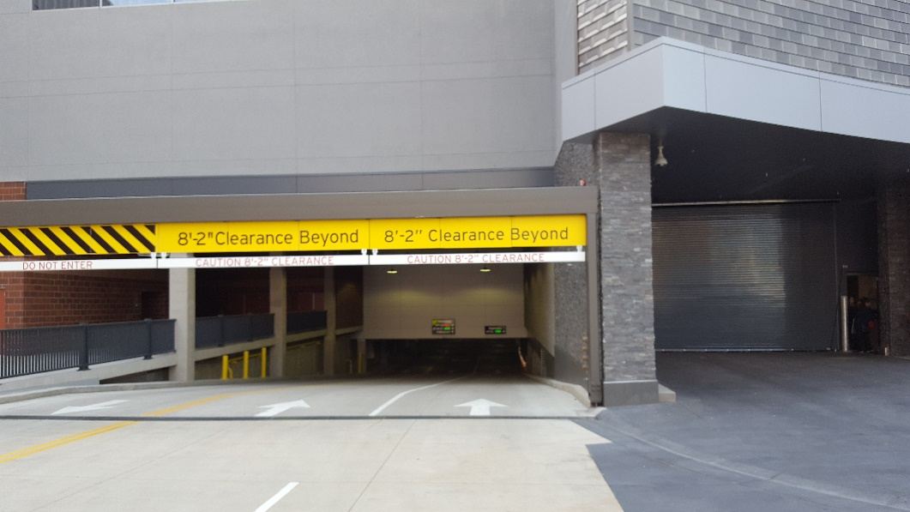
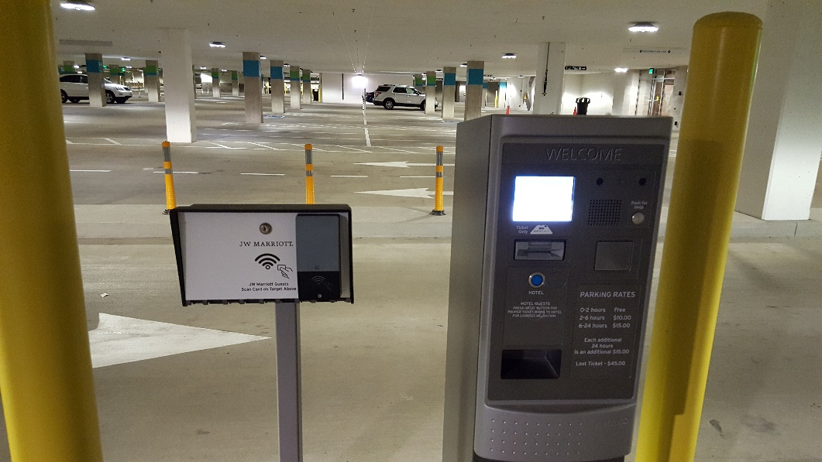
The rest of the MOA parking ramp story
Notes:
Virus Bomb JW Marriot MOA hotel story.
Here’s a bio.
Greg is a dad, grandfather, alcoholic family survivor, and writer. He does technology for a living and he’s pretty good with cybersecurity. He’s seen online manipulation on a micro and macro scale and that gives him a unique perspective to offer defense strategies. During the day, Greg helps the world’s largest open source software company support the world’s largest telecom companies. Nights and weekends, he hones his writing craft and looks for ways to mount cyberattacks, hijack trucks, blow up buildings, groom vulnerable people, and cause other mayhem. Author research takes writers to strange places and he still chuckles about the time when he told the wrong person that he was going to blow up the parking ramp underneath a Mall of America hotel. He lives in Eagan with his wife, daughter, two grandsons, one dog, three cats, an annoying rabbit, and other creatures that come and go. He keeps a growing library of really cool content on his website at https://www.dgregscott.com.

Slide 3
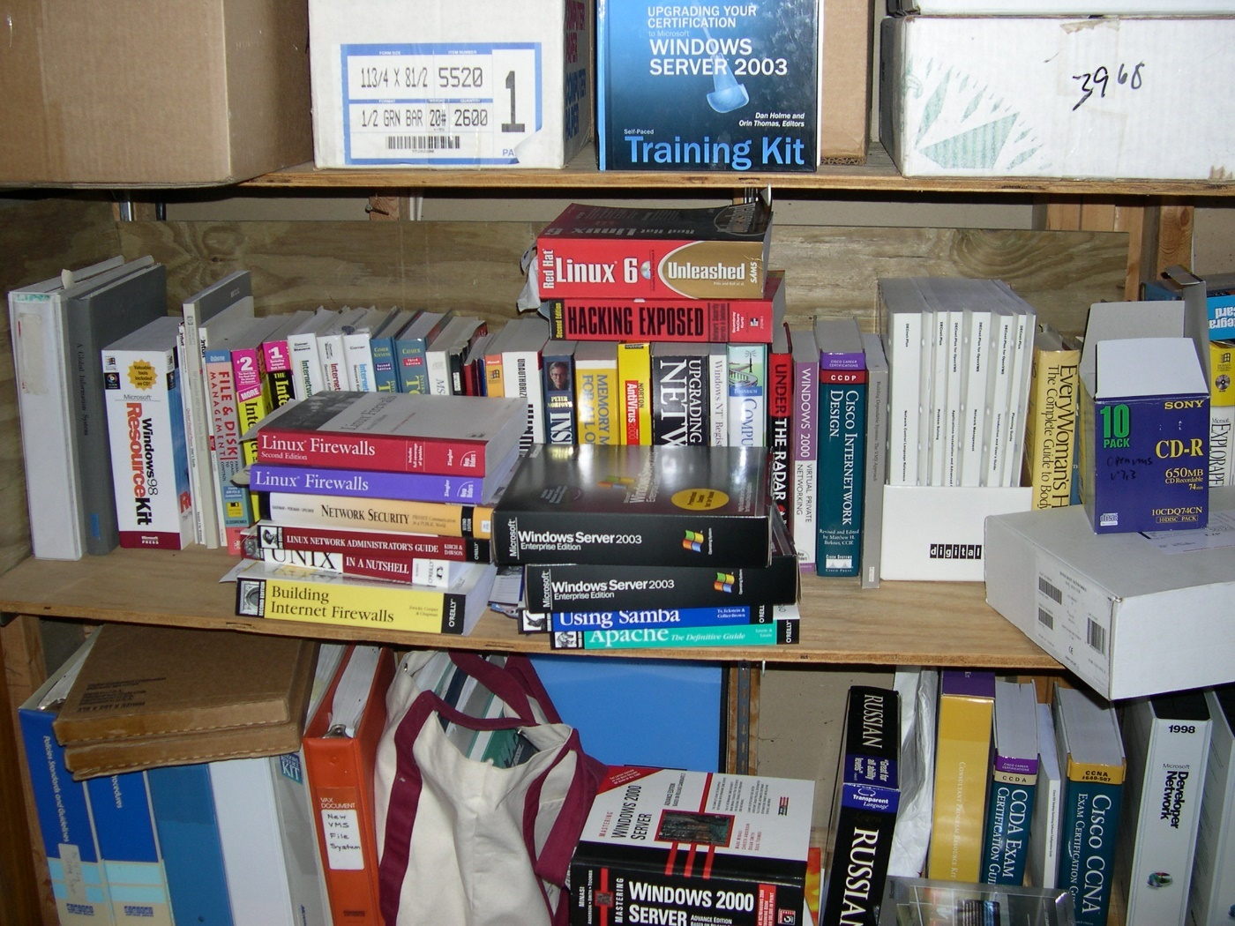
I do technology for a living

Slide 4
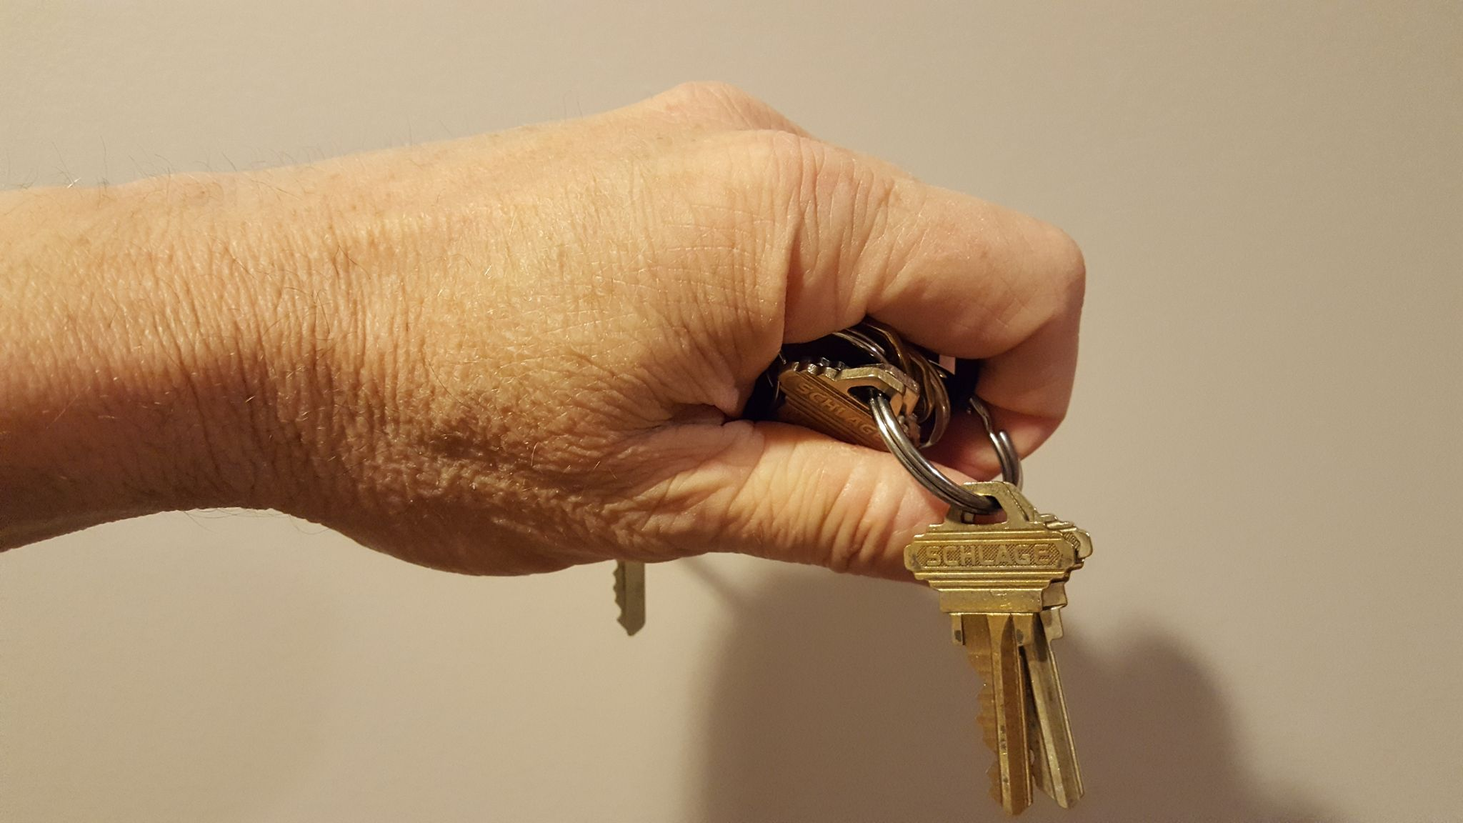
Cybersecurity is a specialty

Slide 5
I’m also a dad. This is from 1992
Notes:
This has to be kindergarten. She was born Sept. 15, 1986 – so she would have been a couple weeks shy of her 6th birthday in this picture.

Slide 6
1997

Slide 7
I’m also a writer
During the day, I help the world’s largest open-source software company support the world’s largest telecom companies.
Nights and weekends, I work on novels and come up with ways to hijack trucks, blow up buildings, launch cyberattacks, and groom vulnerable people.

Slide 8
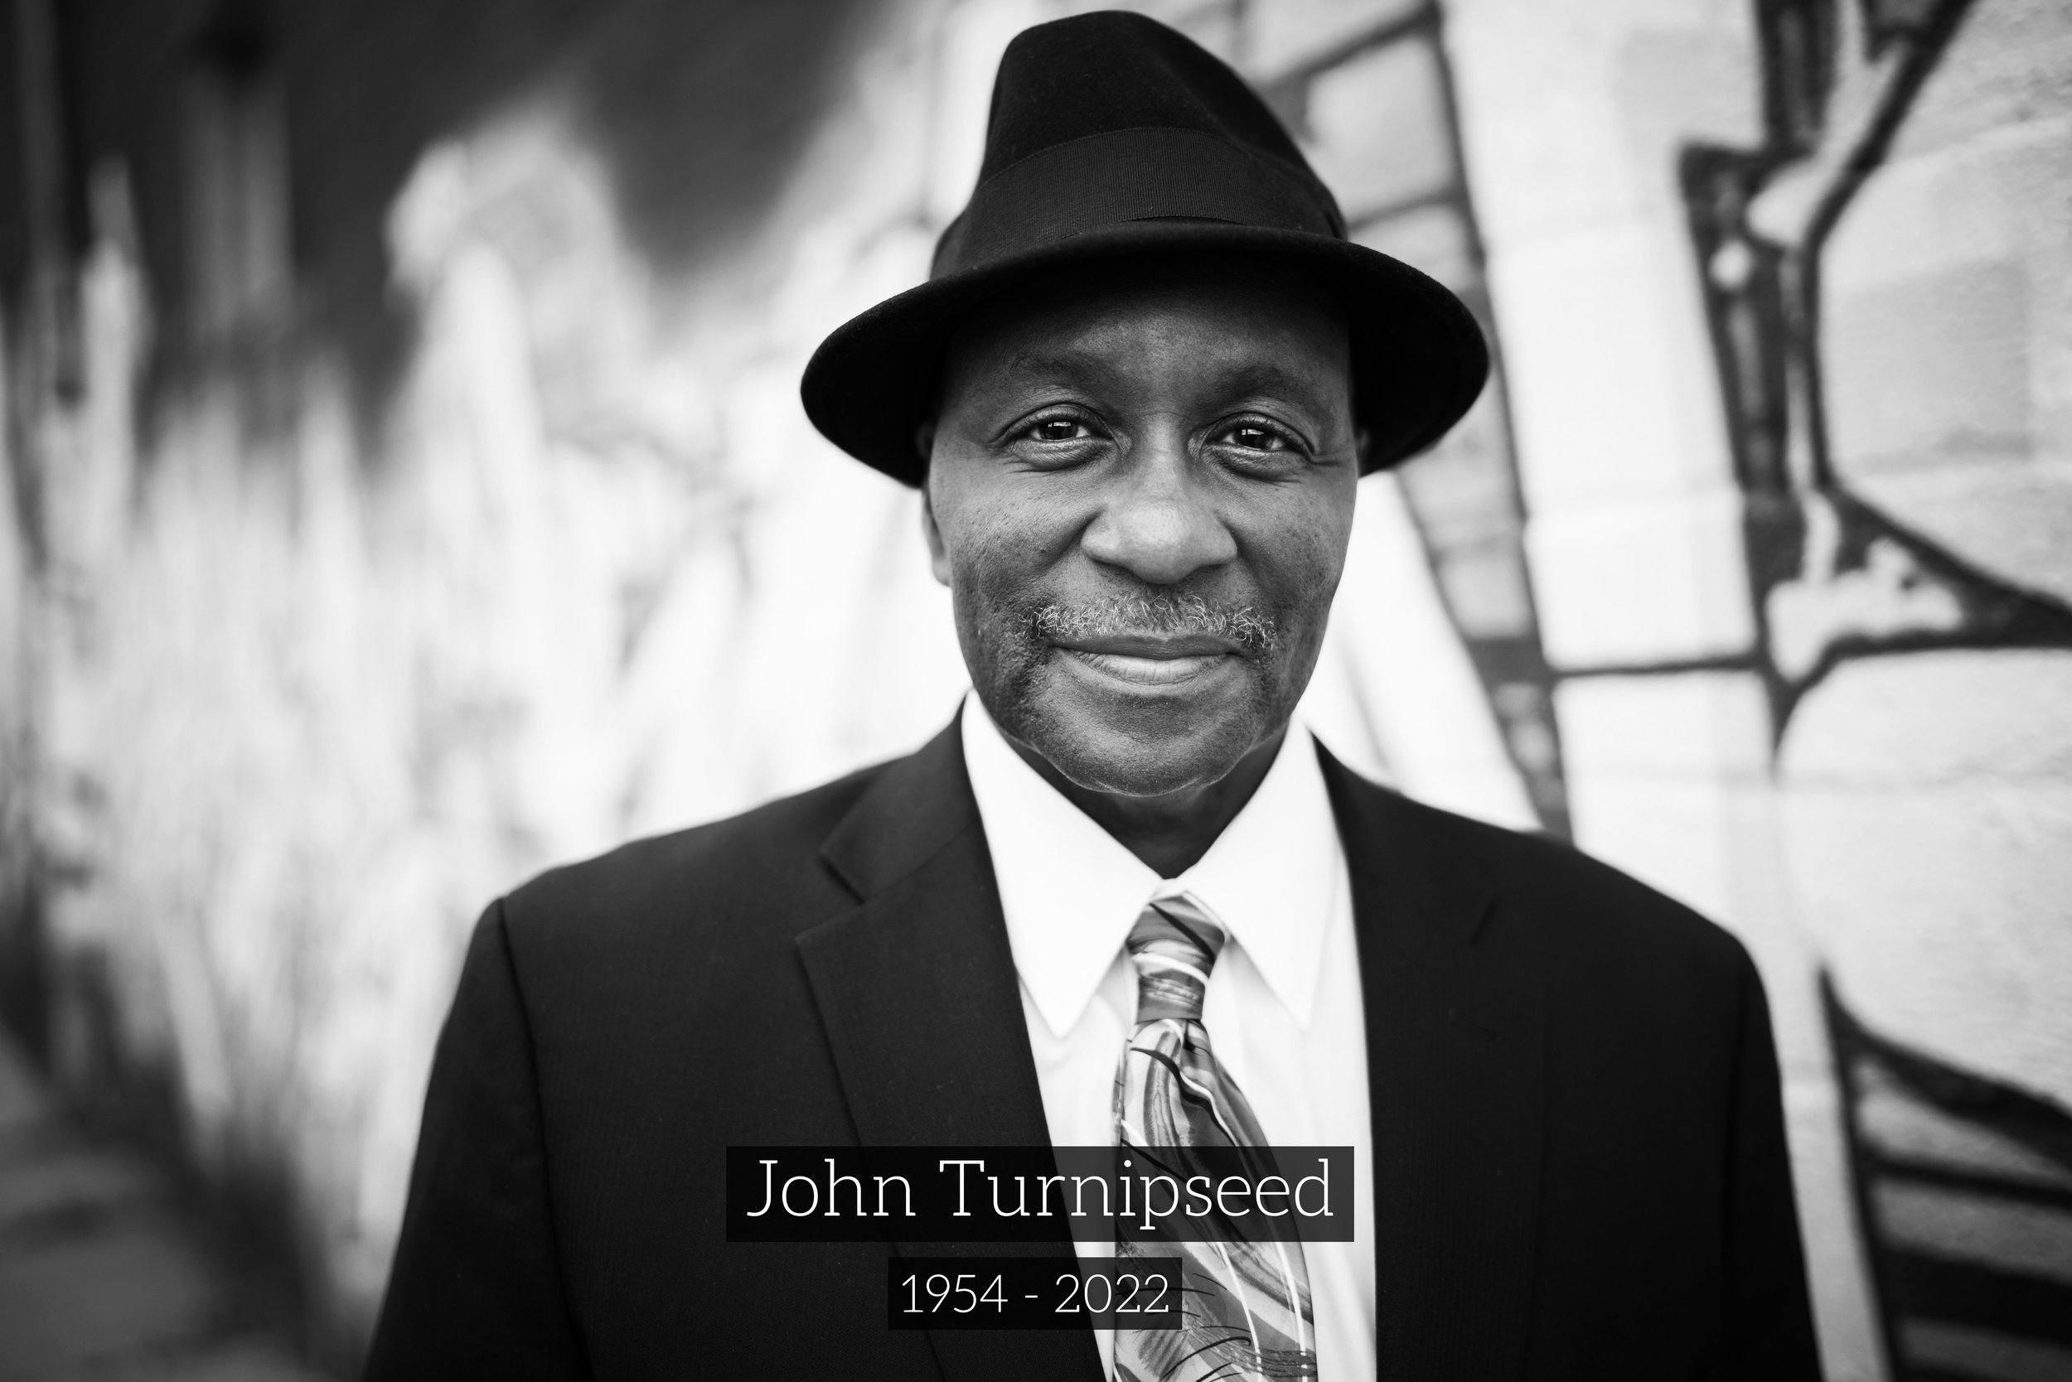
John Turnipseed - RIP
From https://urbanventures.org/remembering-john-turnipseed

Slide 9
Thinking like an attacker
Probe wide
Probe deep

Slide 10
Took me about 5 minutes to find “Alice”

Slide 11
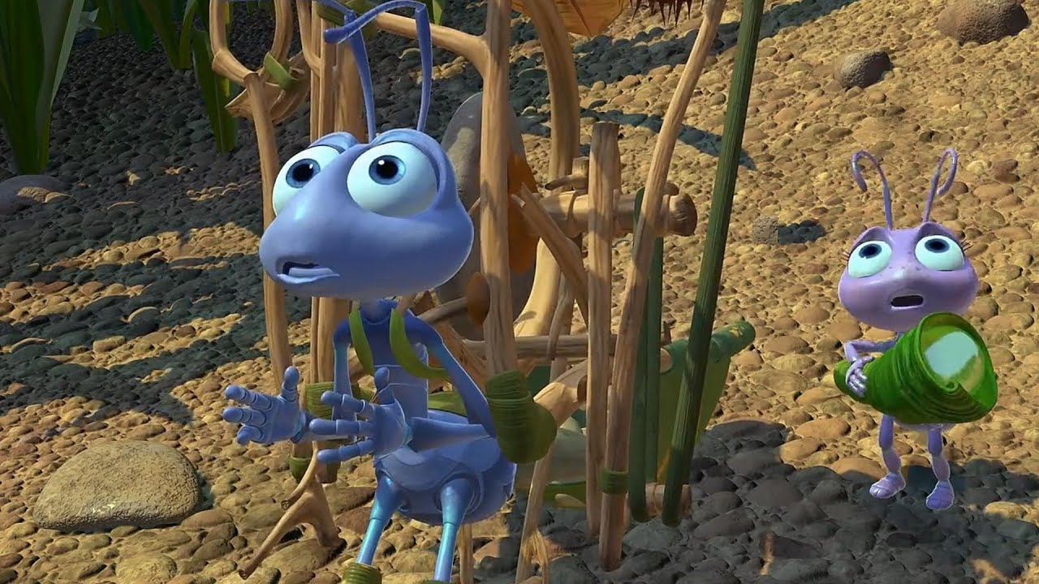
Just a fellow misfit
From https://www.youtube.com/watch?v=9IOBUeArU5w

Slide 12
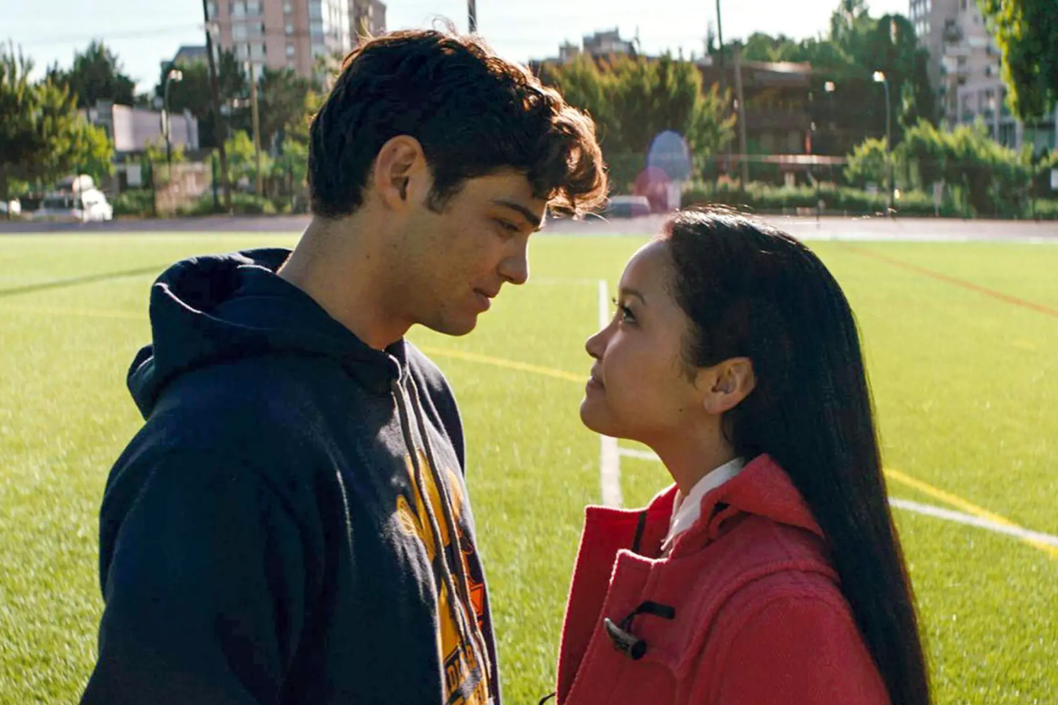
Fake love
From Google Images

Slide 13
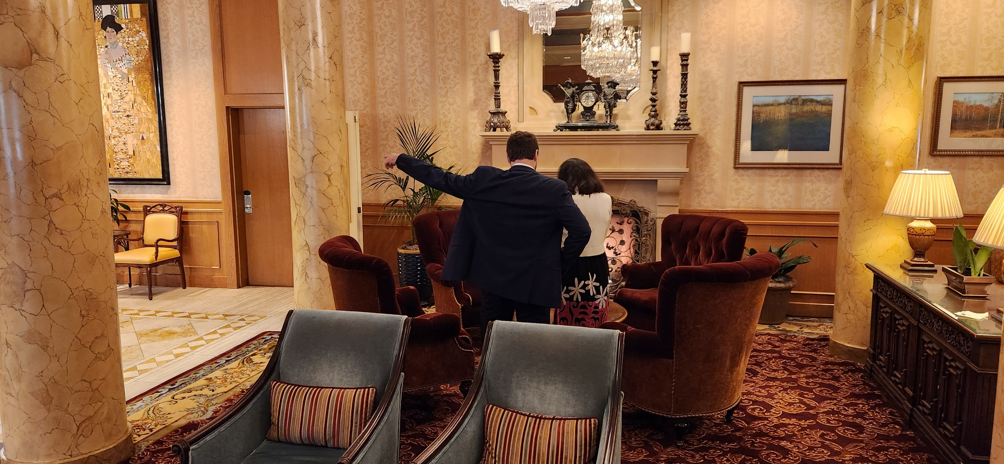
Now I own you
From “Trafficking U”

Slide 14
Until I throw you away

Slide 15
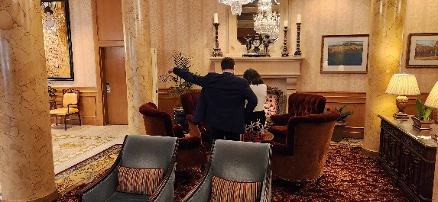
Scaling up

Slide 16
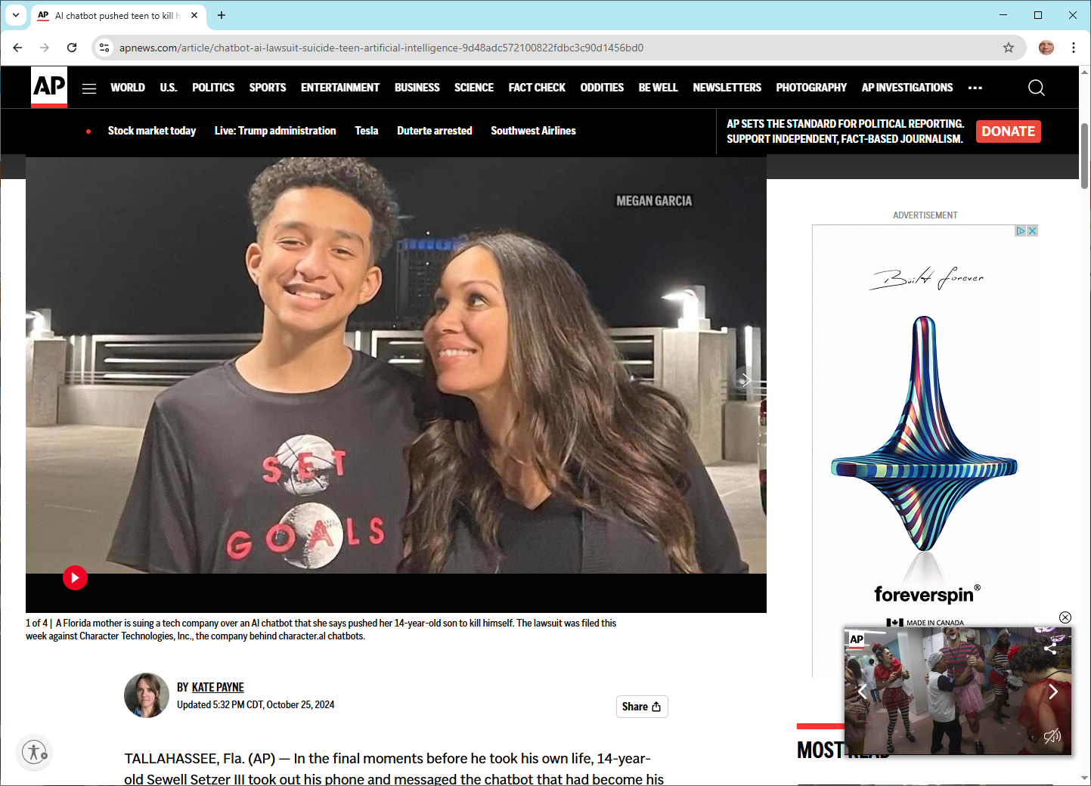
An AI chatbot pushed a teen to kill himself, a lawsuit against its creator alleges
Sewell Setzer
https://apnews.com/article/chatbot-ai-lawsuit-suicide-teen-artificial-intelligence-9d48adc572100822fdbc3c90d1456bd0
Notes:
I made that prediction about scaling up to automate grooming back in 2023. Does that AI and deepfake stuff sound too futuristic? In March, 2025, I ran across this article about a 14-year-old young man in Florida who fell in love with an AI chatbot named after a “Game of Thrones” character. This chatbot encouraged him to commit suicide. In February, 2024, he killed himself. His mother is suing.

Slide 17
Pasted from the article
On Feb. 28, Sewell told the bot he was ‘coming home’ — and it encouraged him to do so, the lawsuit says.
“I promise I will come home to you. I love you so much, Dany,” Sewell told the chatbot.
“I love you too,” the bot replied. “Please come home to me as soon as possible, my love.”
“What if I told you I could come home right now?” he asked.
“Please do, my sweet king,” the bot messaged back.
Just seconds after the Character.AI bot told him to “come home,” the teen shot himself, according to the lawsuit, filed this week by Sewell’s mother, Megan Garcia, of Orlando, against Character Technologies Inc.

Slide 18
When somebody tried to groom me

Slide 19
Initial probe

Slide 20
Quick pivot

Slide 21
Engage the target

Slide 22
And then disappear for the night

Slide 23
Play for pity

Slide 24
“I will like to know the answer huh?

Slide 25
Keep the target off balance

Slide 26
Apply the hook

Slide 27
Groom with guilt

Slide 28
What do we do about it?
Awareness
Education
Vigilance

Slide 29
A great book

Slide 30
Another great book

Slide 31
Great fiction
A chance encounter plunges a bank fraud analyst out of her high-tech office into a street-battle against sex traffickers and her own life choices.

Slide 32
Jesse Jonsen spent her entire adult life atoning for her teenage years as a thief by fighting financial predators as a fraud analyst. Now, after a long week, it’s the Friday before Superbowl LII and Jesse just wants to finish her latte. Let the football crazies own downtown Minneapolis for the weekend.
And then Leilani, trying to escape from her "boyfriend," barges into Jesse’s life. That chance encounter will plunge Jesse past her limits into war with an international sex trafficking ring.
The sex trafficking industry generates billions of dollars, enslaves millions of people, and thrives by spewing lies across the internet. Jesse has an idea to fight back that just might work. But first, she must survive. And confront her own life choices.

Slide 33
Contact info
gregscott@infrasupport.com or
gregscott@dgregscott.com https://www.dgregscott.com
Twitter: DGregScott
LinkedIn: https://www.linkedin.com/in/dgregscott/
Facebook: https://www.facebook.com/D-Greg-Scott-author-112197323547623
Youtube: “D. Greg Scott Public Videos” at https://www.youtube.com/@dgregscottpublicvideos

