Slide 1
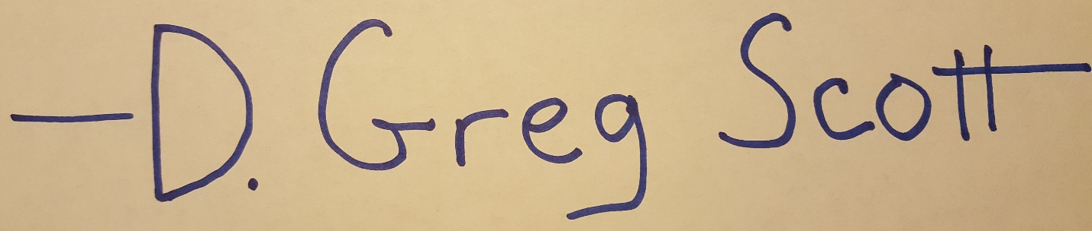
Cybersecurity
What We’re up Against and How to Kick Bad Guys’ Butts
CISSP Number 358671

Slide 2
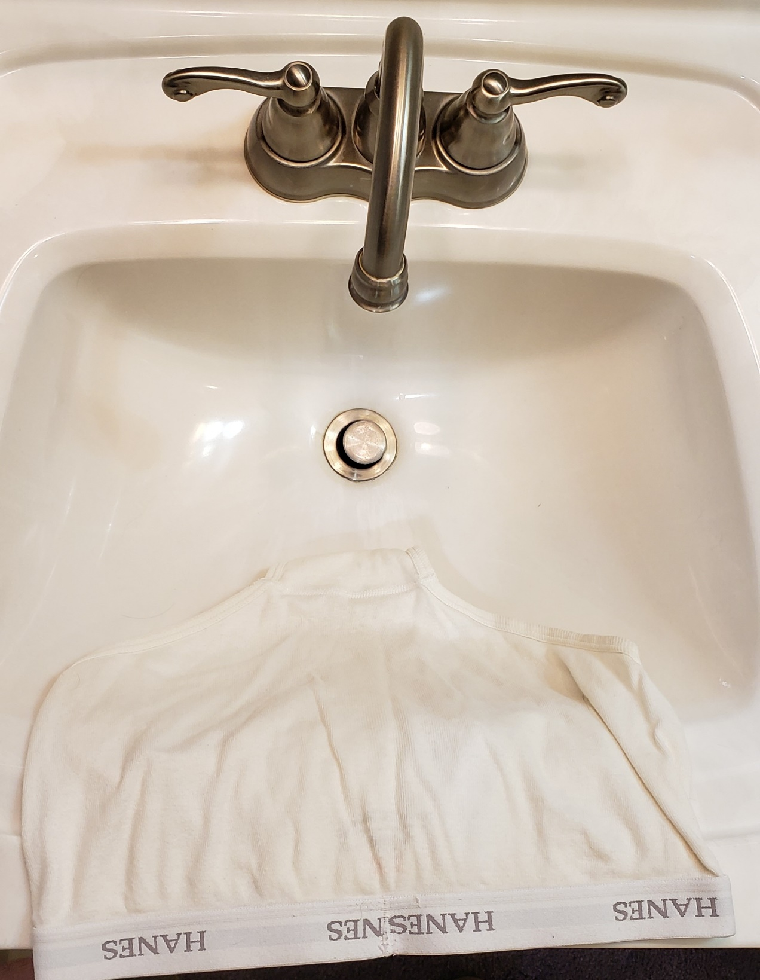
Who says IT is boring?
Notes:
The problem with cybersecurity presentations is, there’s always too much material.

Slide 3
Boring statistics that hit home
From https://www.broadbandsearch.net/blog/alarming-cybercrime-statistics
A cyberattack happens once every 39 seconds.
  “The computers in our study were attacked, on average, 2,244 times a day.”
78 percent of organizations in the US experienced a cyberattack in 2019.
23 percent of Americans have either had their credit card of financial information stolen by attackers, or they know someone who has.
Data breaches effected 30 percent of all US consumers in 2018.
The U.S. economy loses between $57 billion and $109 billion per year to malicious cyber activity.

Slide 4
Eight seconds in my basement
Oct 7 12:38:55 infra2020-fw kernel: IN=enp2s0 OUT= MAC=00:30:18:c5:e3:b8:a0:a3:e2:63:de:20:08:00 SRC=171.242.158.152 DST=216.160.2.135 LEN=44 TOS=0x00 PREC=0x00 TTL=49 ID=60708 PROTO=TCP SPT=34494 DPT=23 WINDOW=47045 RES=0x00 SYN URGP=0
Oct 7 12:38:59 infra2020-fw kernel: IN=enp2s0 OUT= MAC=00:30:18:c5:e3:b8:a0:a3:e2:63:de:20:08:00 SRC=195.54.161.104 DST=216.160.2.136 LEN=44 TOS=0x00 PREC=0x00 TTL=241 ID=39863 PROTO=TCP SPT=42098 DPT=218 WINDOW=1024 RES=0x00 SYN URGP=0
Oct 7 12:39:00 infra2020-fw kernel: IN=enp2s0 OUT= MAC=00:30:18:c5:e3:b8:a0:a3:e2:63:de:20:08:00 SRC=192.241.220.248 DST=216.160.2.133 LEN=44 TOS=0x00 PREC=0x00 TTL=246 ID=54321 PROTO=TCP SPT=40013 DPT=110 WINDOW=65535 RES=0x00 SYN URGP=0
Oct 7 12:39:00 infra2020-fw kernel: IN=enp2s0 OUT= MAC=00:30:18:c5:e3:b8:a0:a3:e2:63:de:20:08:00 SRC=171.235.221.124 DST=216.160.2.136 LEN=52 TOS=0x00 PREC=0x00 TTL=49 ID=29656 DF PROTO=TCP SPT=50326 DPT=445 WINDOW=8192 RES=0x00 SYN URGP=0
Oct 7 12:39:02 infra2020-fw kernel: IN=enp2s0 OUT= MAC=00:30:18:c5:e3:b8:a0:a3:e2:63:de:20:08:00 SRC=79.66.18.65 DST=216.160.2.133 LEN=40 TOS=0x00 PREC=0x00 TTL=53 ID=0 DF PROTO=TCP SPT=54355 DPT=443 WINDOW=0 RES=0x00 RST URGP=0
Oct 7 12:39:03 infra2020-fw kernel: IN=enp2s0 OUT= MAC=00:30:18:c5:e3:b8:a0:a3:e2:63:de:20:08:00 SRC=45.234.63.120 DST=216.160.2.132 LEN=52 TOS=0x00 PREC=0x00 TTL=115 ID=16530 DF PROTO=TCP SPT=54750 DPT=445 WINDOW=8192 RES=0x00 SYN URGP=0

Slide 5
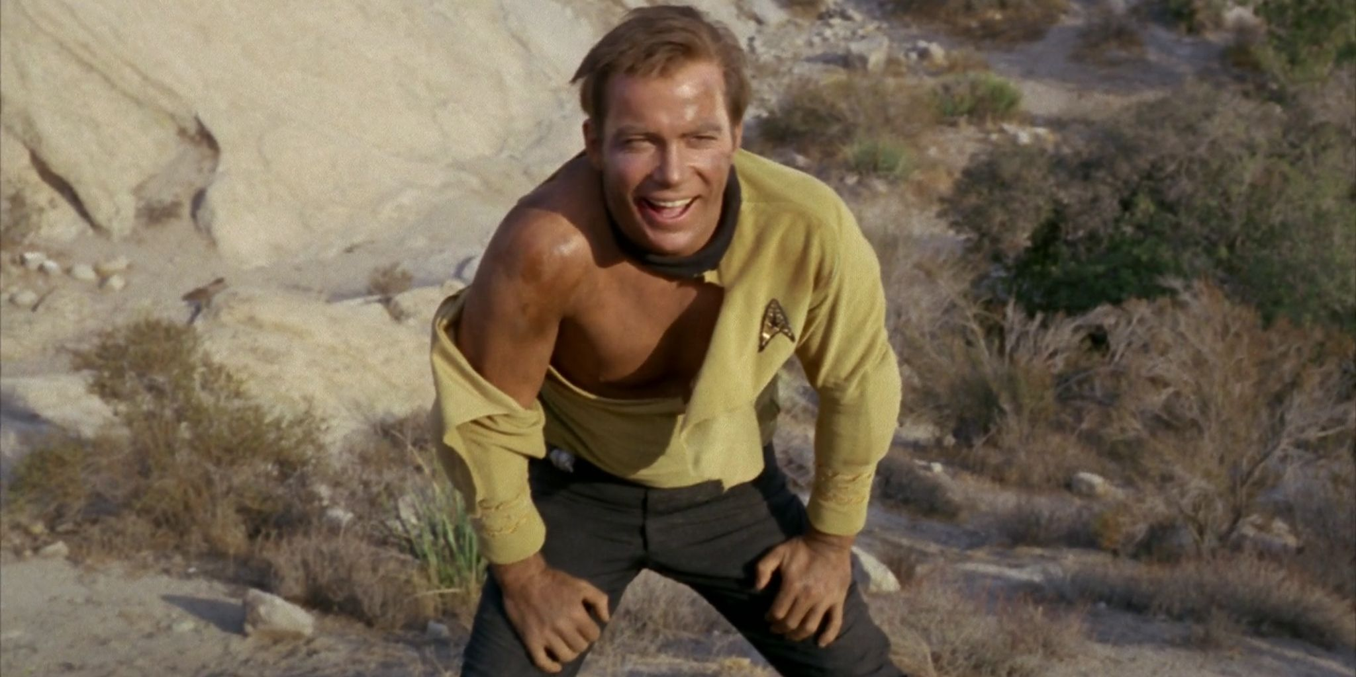
I need more than statistics and numbers. Give me real stories.

Slide 6
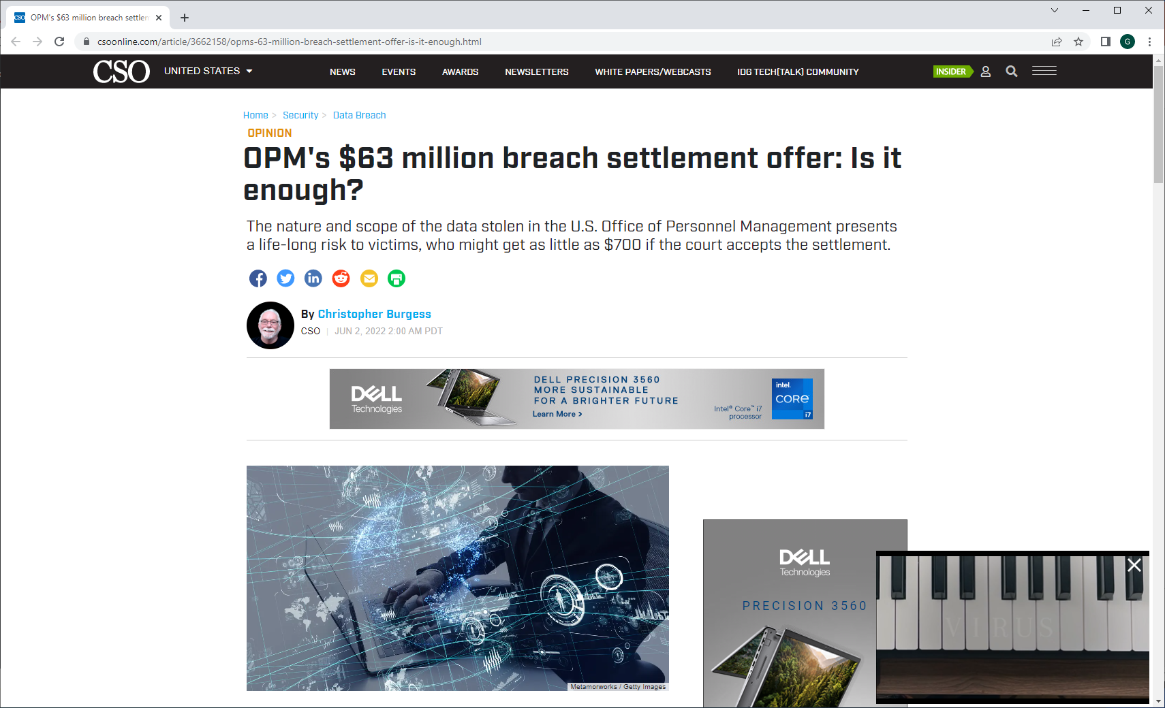

Slide 7

Supply Chain Attack: The Big One in 2020
https://www.dgregscott.com/solarwinds-fallout-so-what-and-now-what/

Slide 8
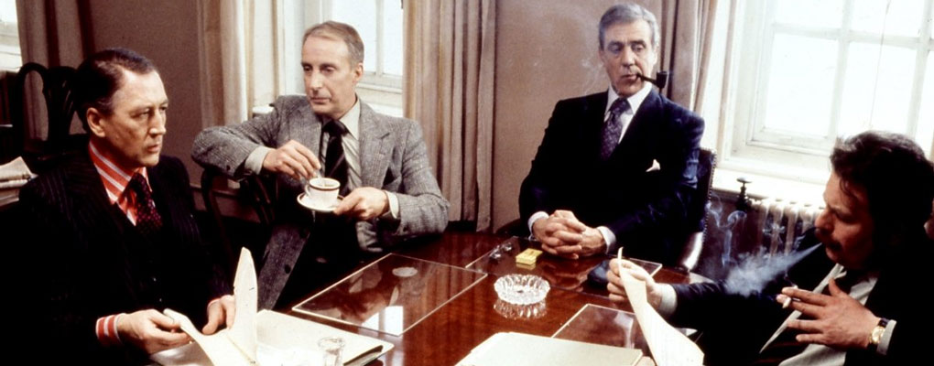
What’s a Supply Chain Attack?
Spy movie – good guys planning how to save the world.
Image from https://www.deadgoodbooks.co.uk/nicholas-searle-realistic-spy-movies/

Slide 9
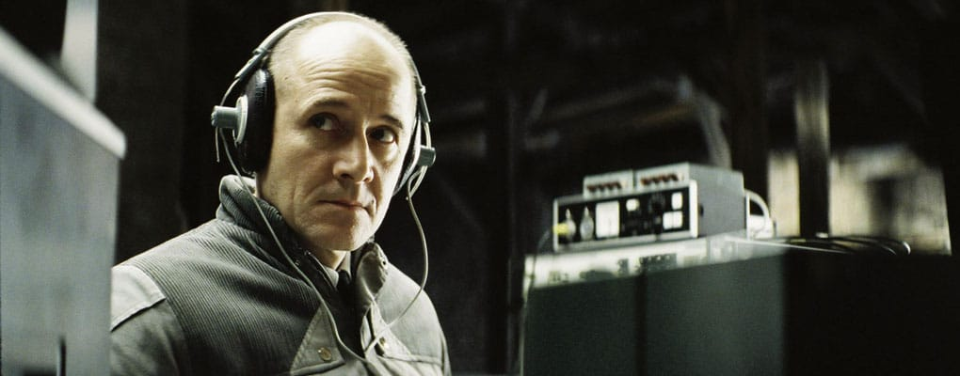
What’s a Supply Chain Attack?
But the good-guy room is bugged. Bad guys are listening.
Image from https://www.deadgoodbooks.co.uk/nicholas-searle-realistic-spy-movies/

Slide 10
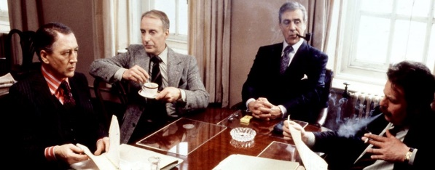
Q: How would bad guys plant bugs in every good-guy room in the world?
Image from https://www.deadgoodbooks.co.uk/nicholas-searle-realistic-spy-movies/

Slide 11
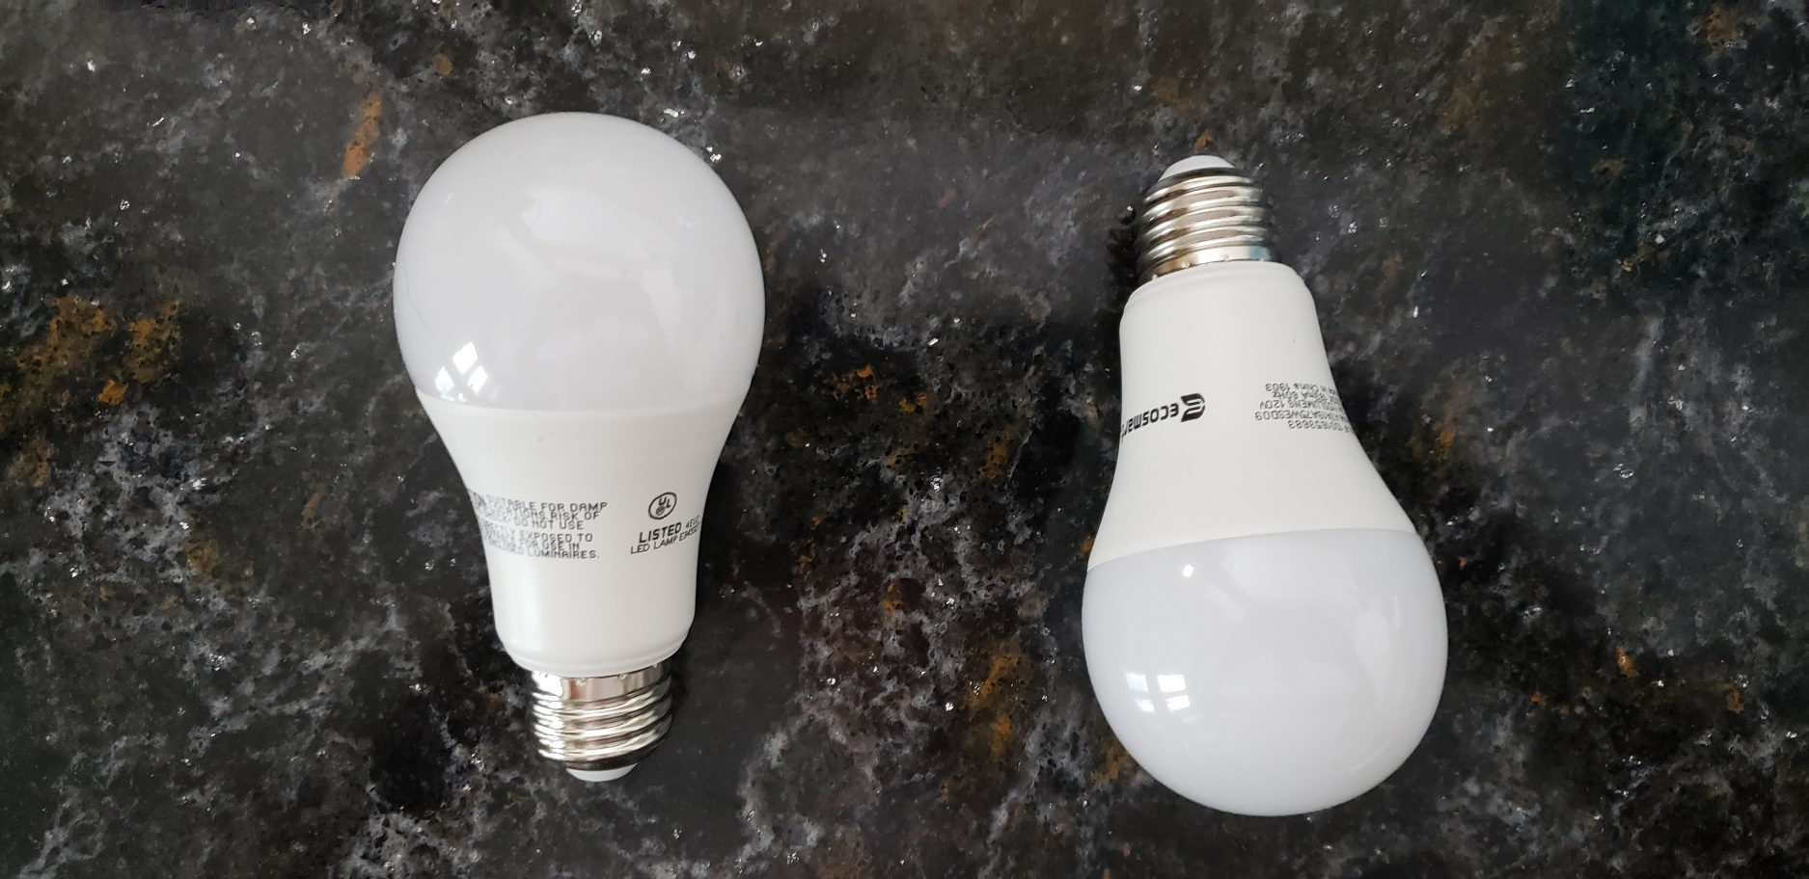
A: Take over the lightbulb factory
Plant bugs in every lightbulb.
When good guys change bulbs, bad guys own another room.

Slide 12
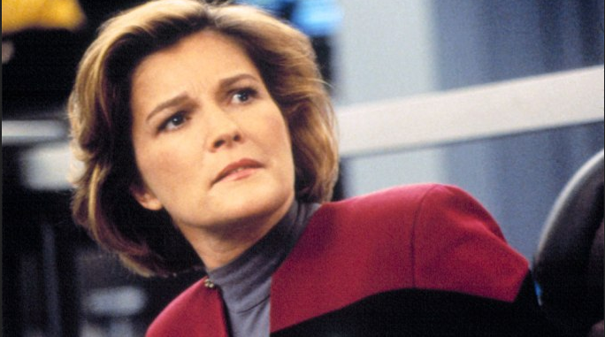
But I’m not big enough for anyone to attack

Slide 13
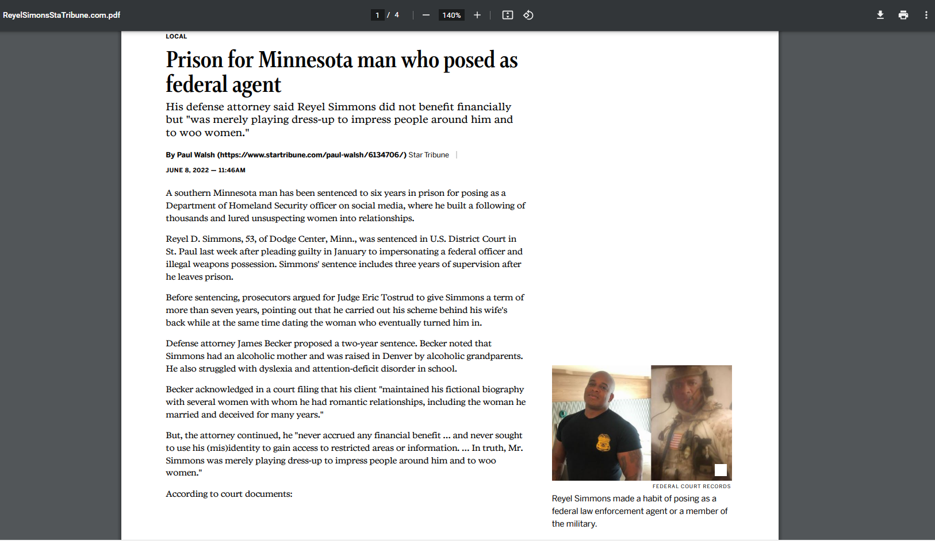

Slide 14
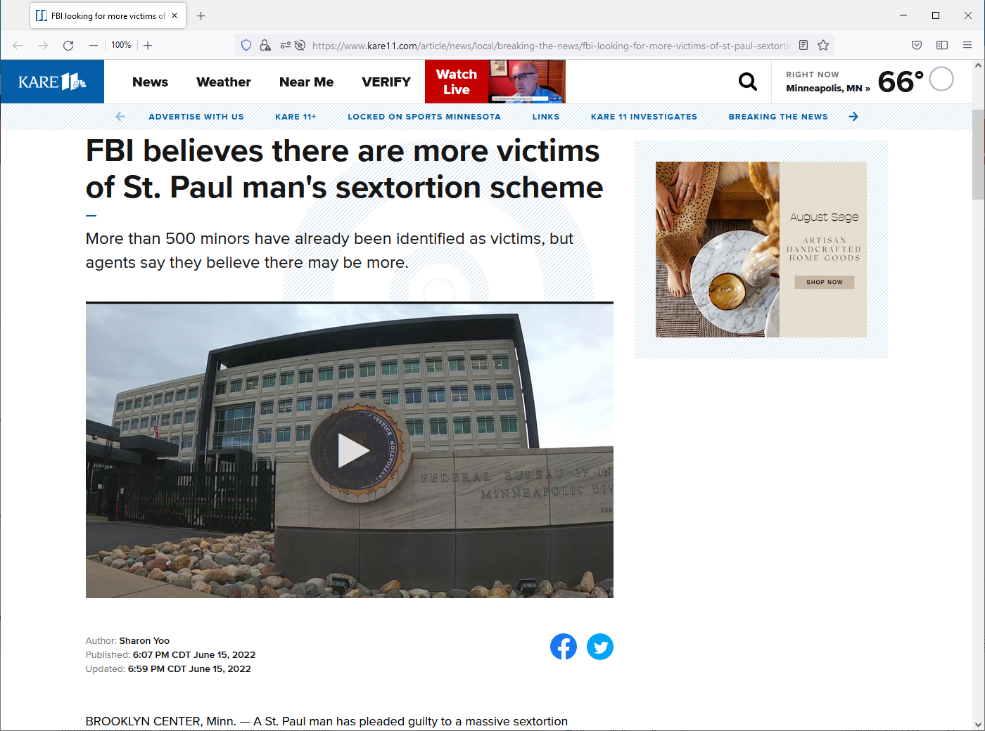
FBI Supervisory Special Agent Brenda Born says Chu Vang targeted 500 minors.
"We were able to uncover approximately 75 identifications and monikers he was using to communicate with the victims," Born said.
https://www.kare11.com/article/news/local/breaking-the-news/fbi-looking-for-more-victims-of-st-paul-sextortion-case/89-ae338020-6790-4f8f-8a41-491a1d292741

Slide 15
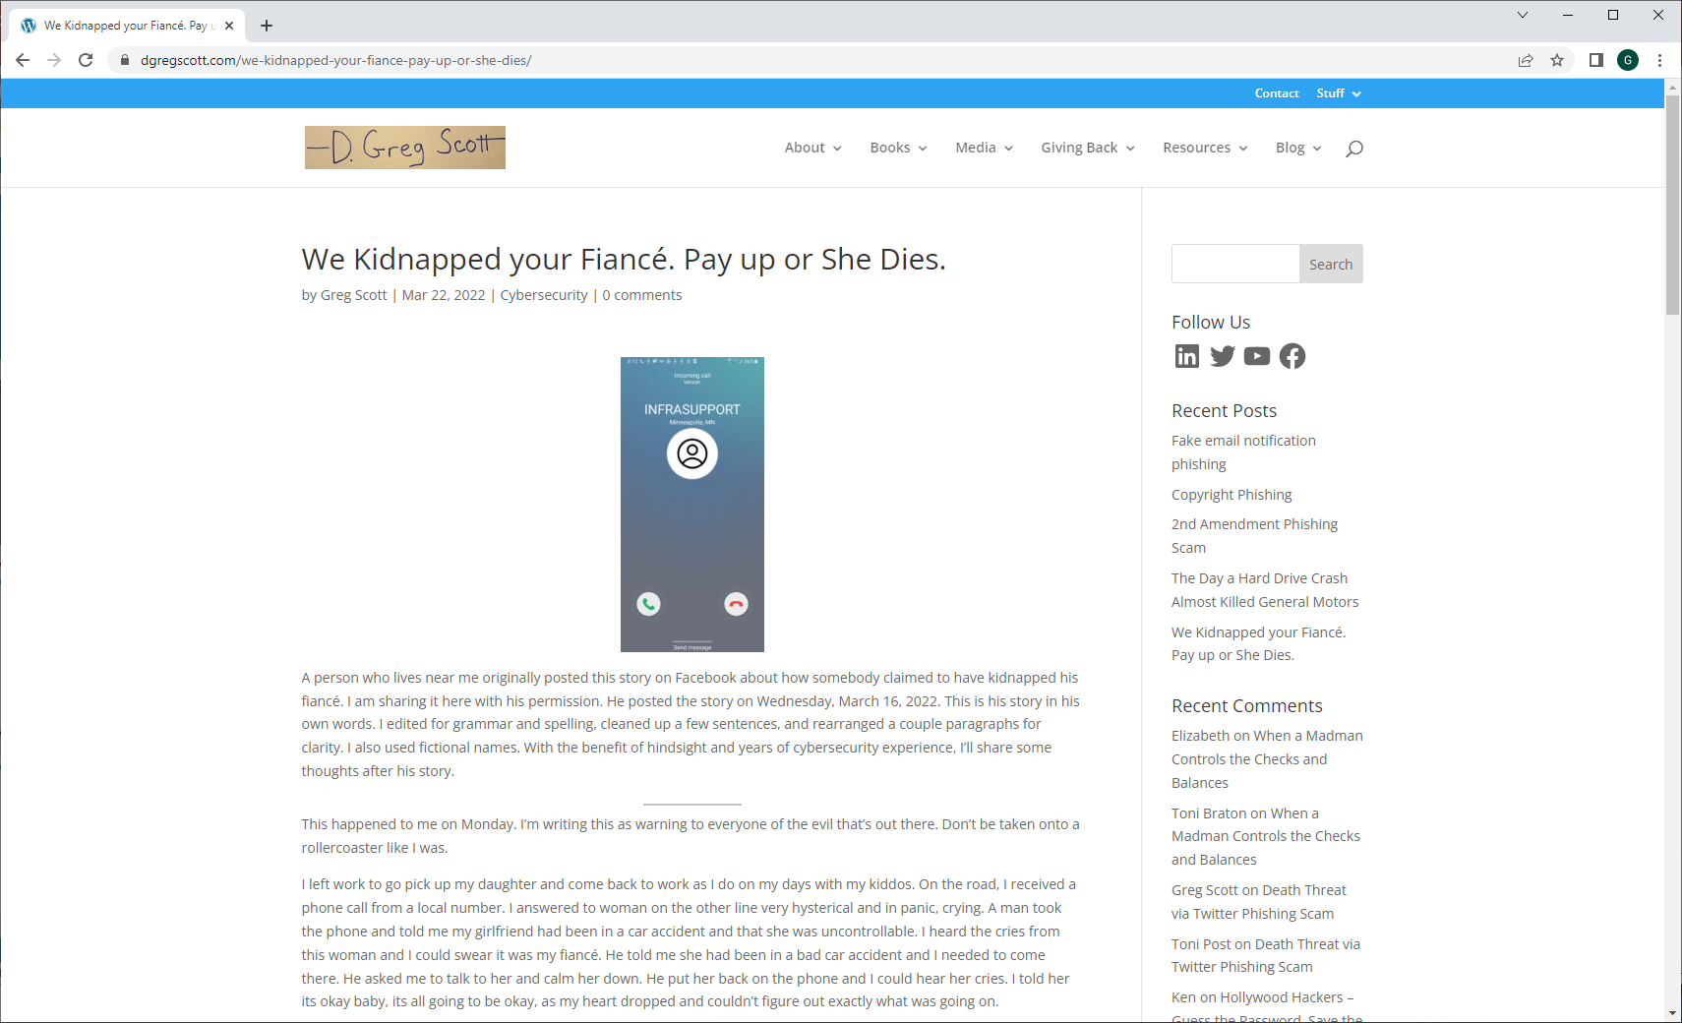

Slide 16
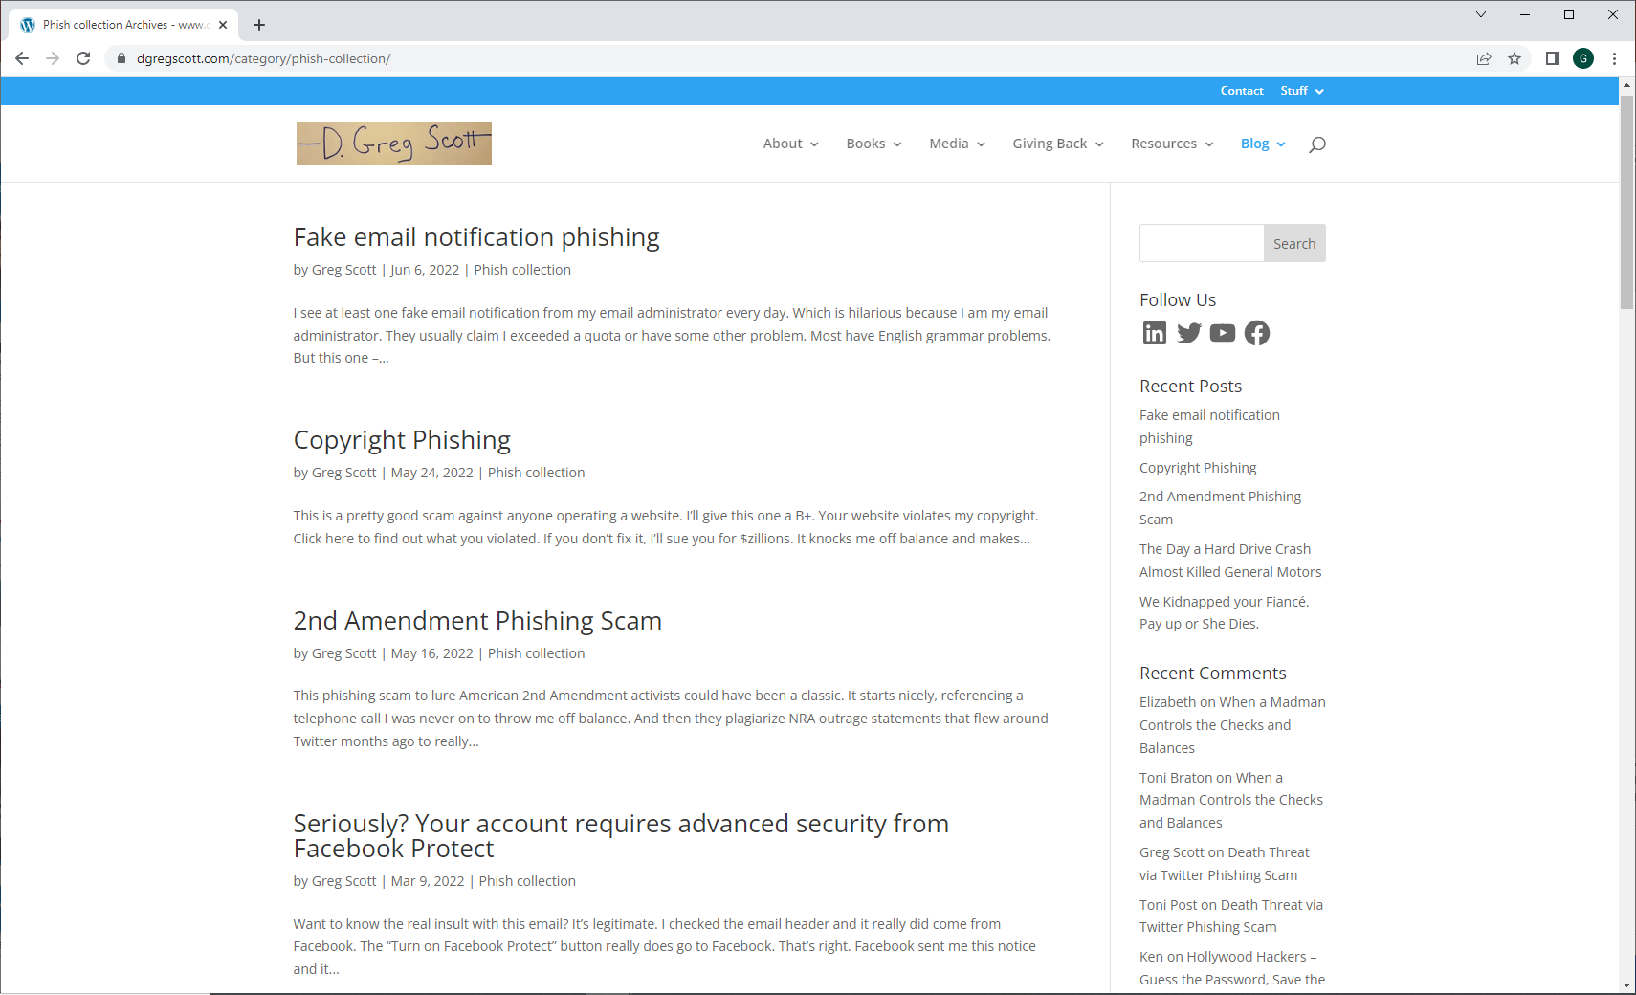

Slide 17
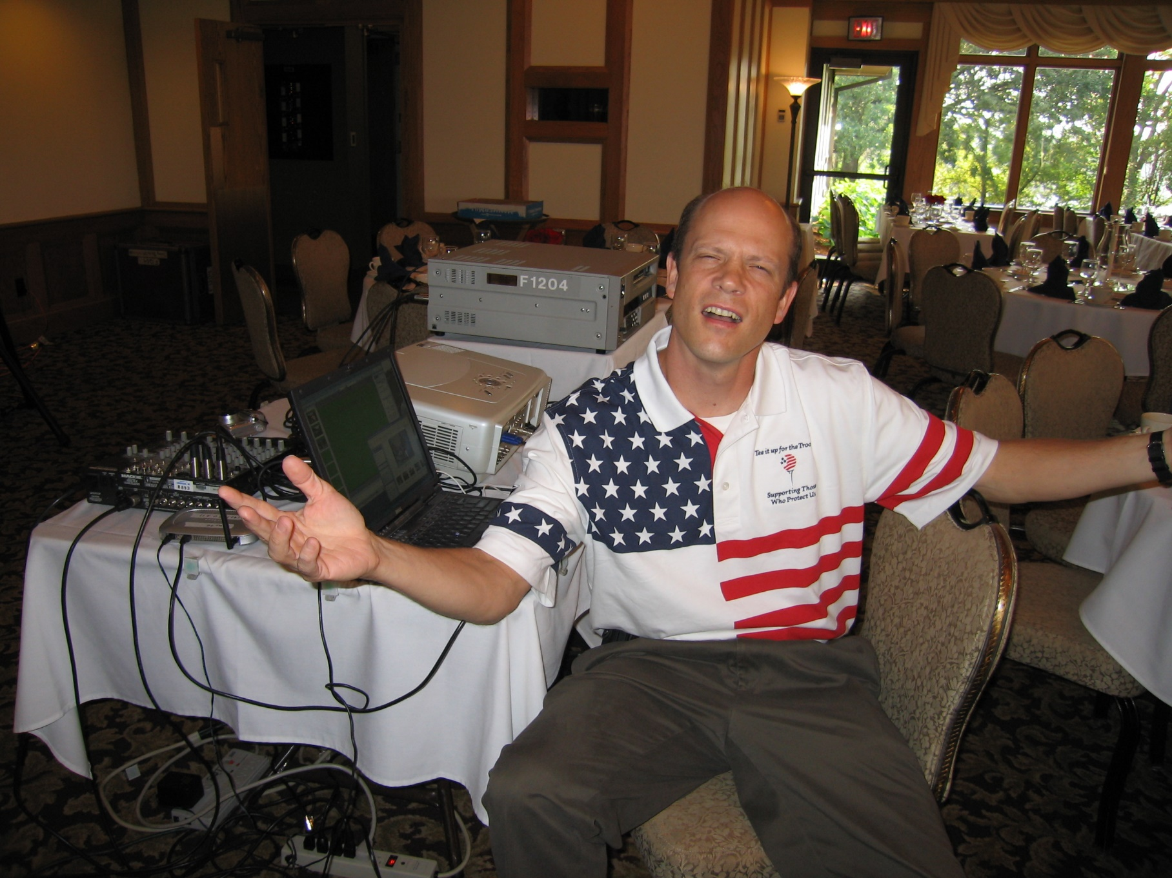
Here’s where it gets personal

Slide 18
I am a repeat cyber victim myself.
  Late November, 2011, somebody tried to steal more than $14,000 with one of my credit cards
  I tracked down names, dates, and details and gave it all to the FBI
  We traded a few emails and then…..
  I’m still waiting
  2008 Norm Coleman for Senate Campaign
    Details here:
    http://www.dgregscott.com/gross-security-lapse-hurt-us-senate-campaign/
  November, 2000 attack against my DNS server
  The FBI and I go way back.
  https://www.dgregscott.com/the-fbi-and-bureaucracy-and-me/

Slide 19
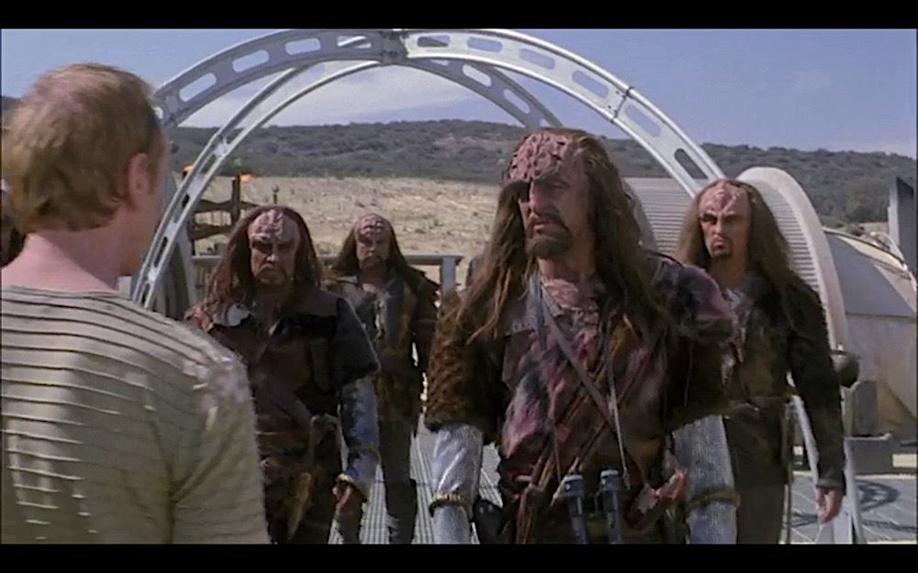
How?
How do bad guys plunder good guys, seemingly at will?
And why do business leaders and politicians keep hiding behind weenie excuses?

Slide 20
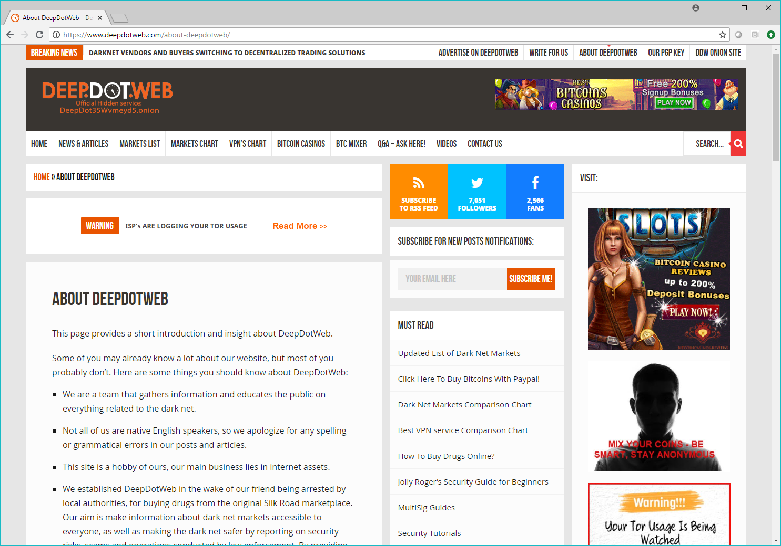
How do bad guys win?
They collaborate.

Slide 21
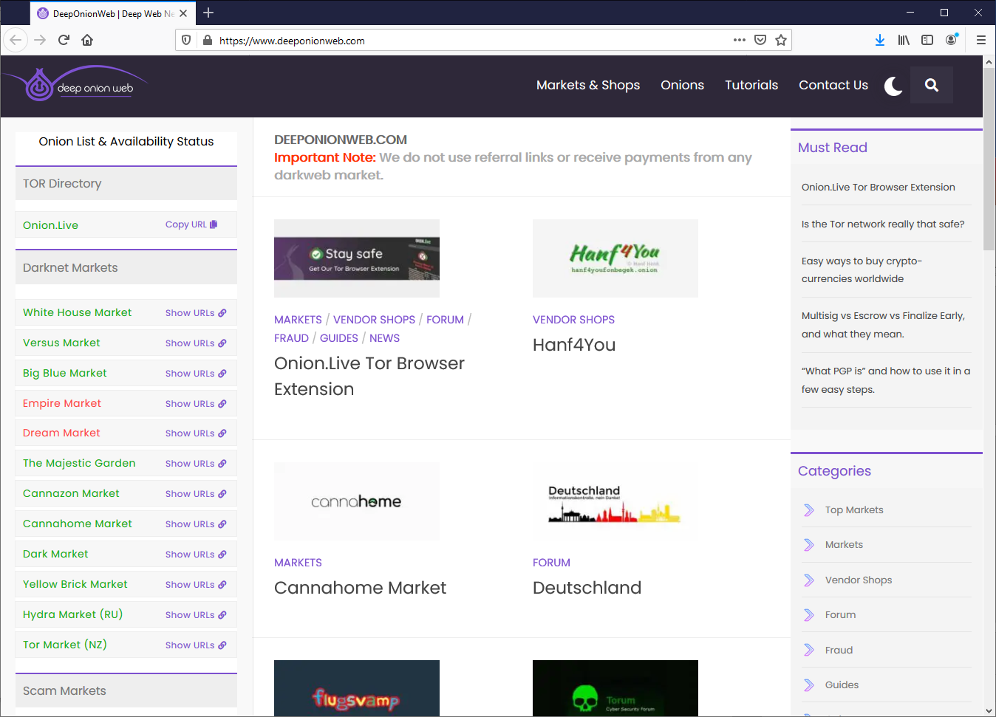
And they adapt

Slide 22
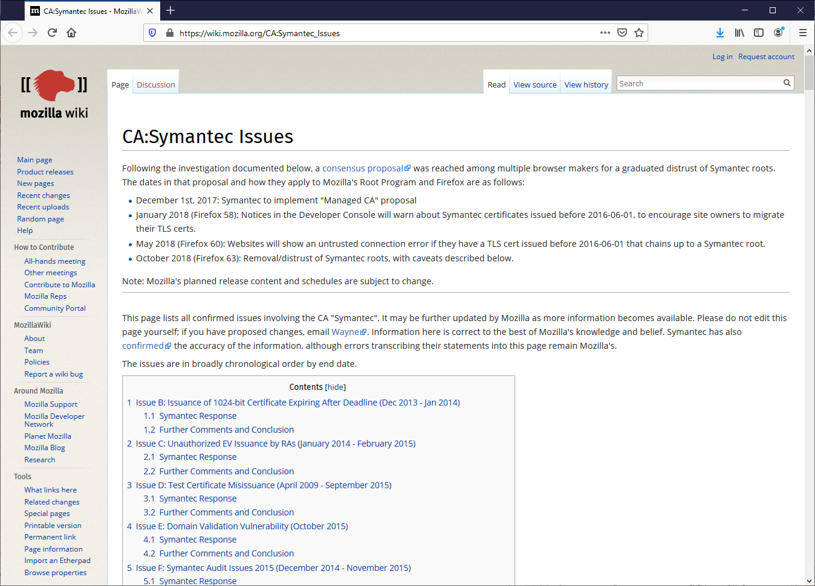
How do good guys lose?
CA trust failures

Slide 23

Institutional failures

Slide 24
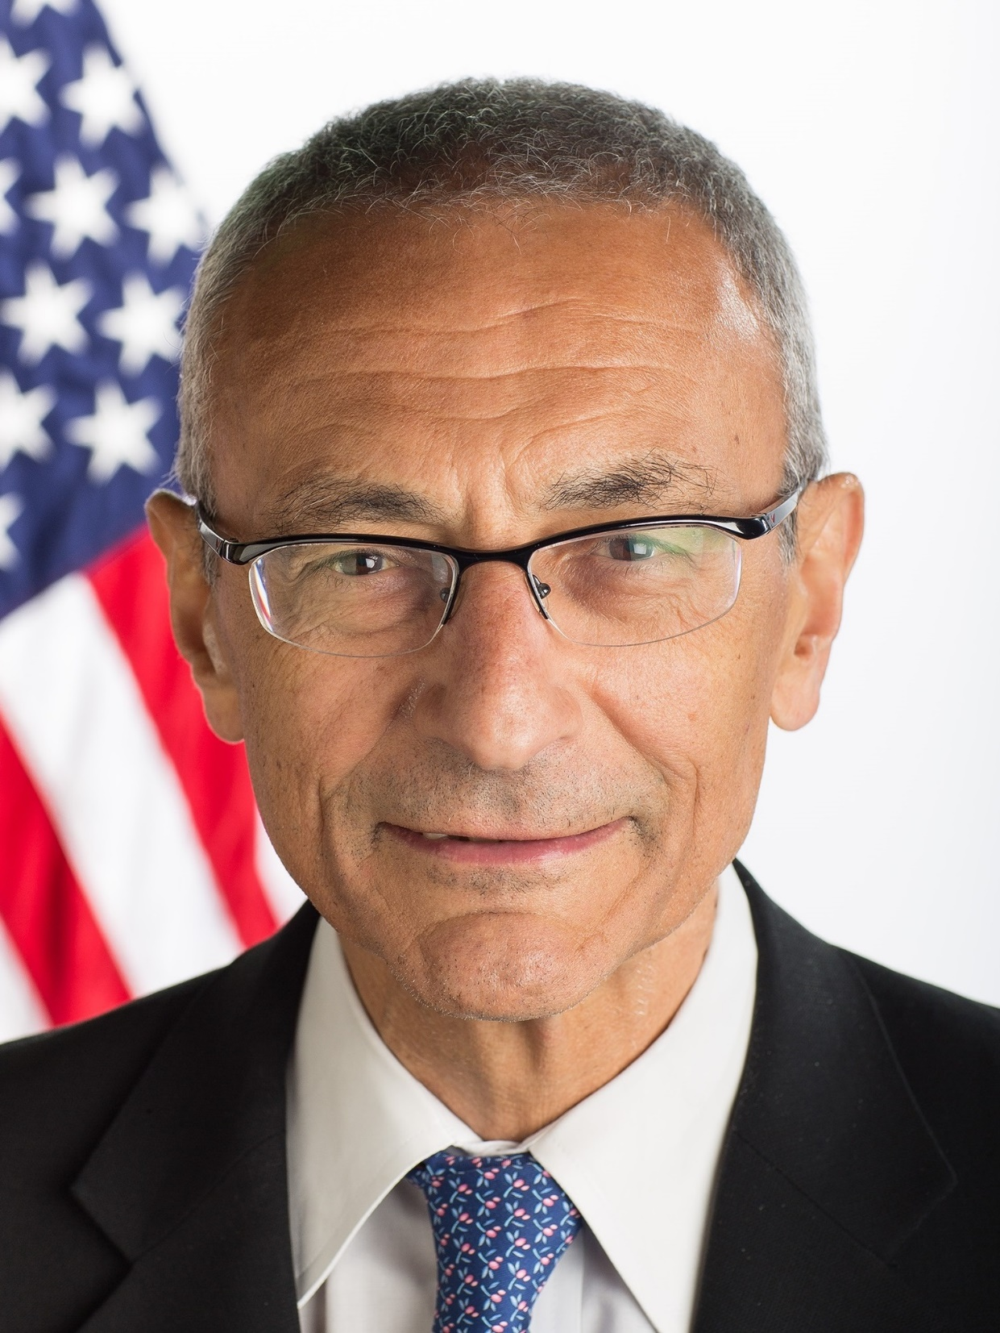
Willful ignorance
John Podesta, Hilary Clinton campaign manager.
He gave his email password to the Russians in a 2016 phishing scam.

Slide 25
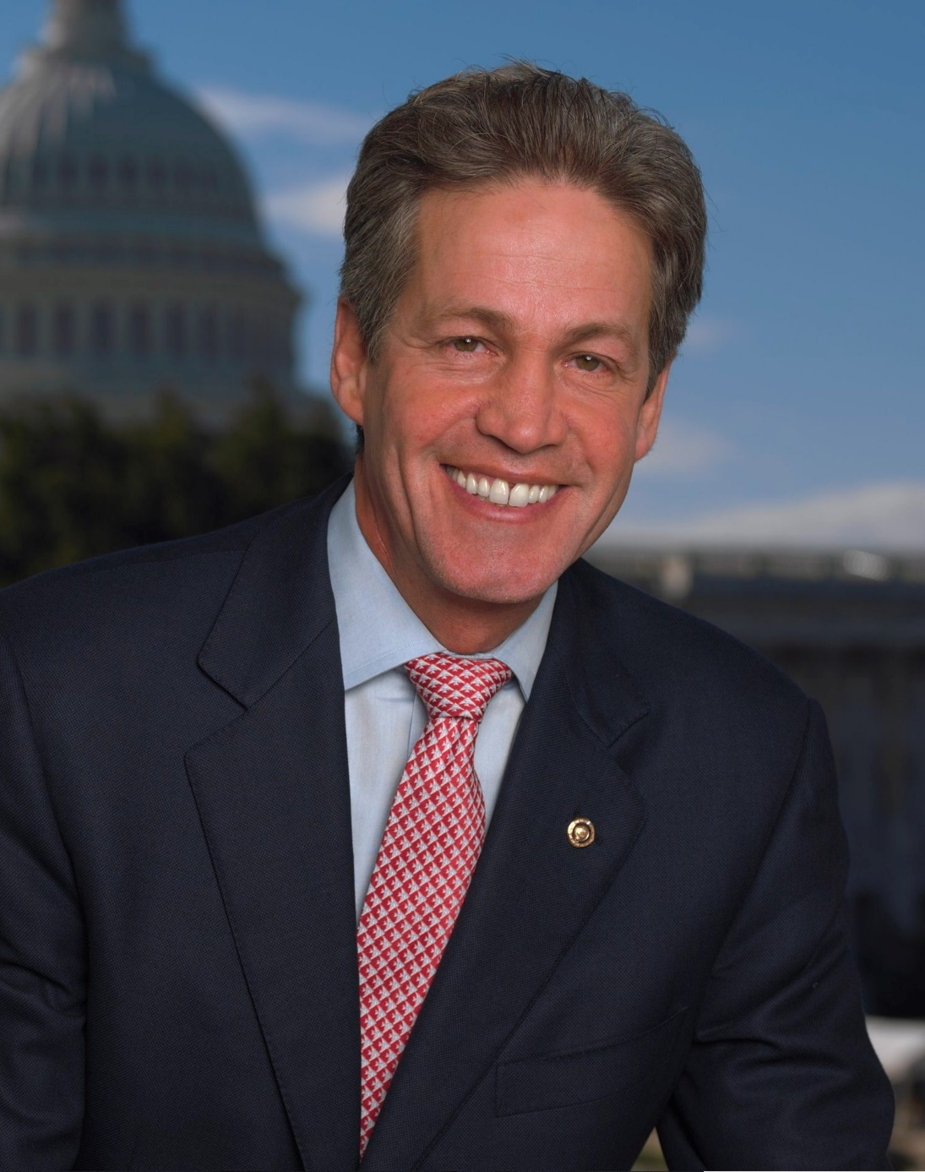
Willful ignorance on both sides of the political aisle
Norm Coleman, former US Senator from Minnesota.
Exposed a spreadsheet with private donor information on his campaign website in 2008.

Slide 26

Stolen government attack tactics
Notes:
Stuxnet, Snowden, Reality Winner, Shadow Brokers, Russian Solarwinds attack, …

Slide 27
Asleep at the Switch
https://www.dgregscott.com/solarwinds-fallout-so-what-and-now-what/

Slide 28
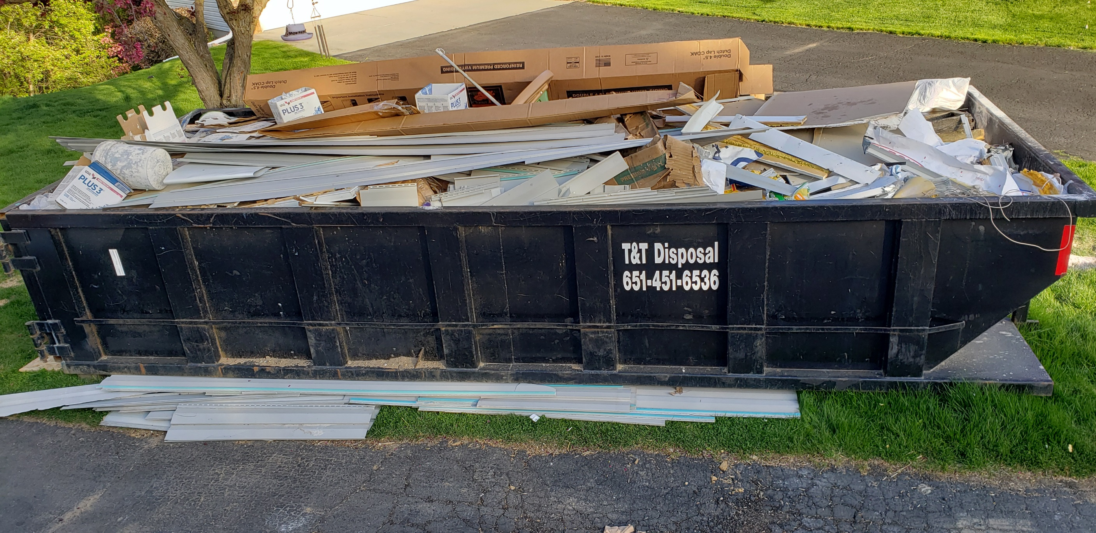
Notes:
This is the state of cybersecurity today. I was thinking about setting this dumpster on fire so I could get a dumpster fire picture, but the insanity passed.

Slide 29
Time to recap – what are we up against?
Bad guys have a vast underground supply chain and support network.
The entities we’re supposed to trust with the Internet security infrastructure have all been compromised.
Personal information about nearly all adult Americans is up for sale on underground websites.
Thousands of businesses have been compromised.
The United States government is both a perpetrator and a victim.
If your identity is stolen, law enforcement is unwilling or unable to help.
Lies fly around the planet lots faster than truth.

Slide 30
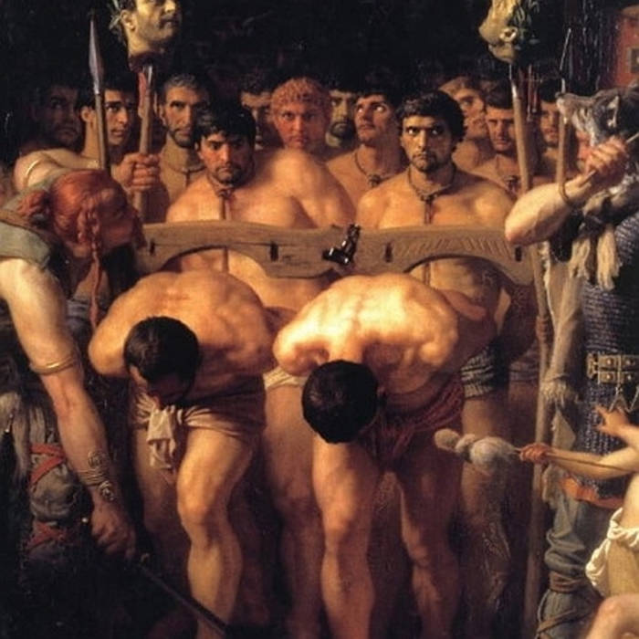
Maybe we should just give up

Slide 31
Buy a cave in Montana and hide.
Pay with cash.
Bad guys have unlimited time and creativity.
You don’t!

Slide 32
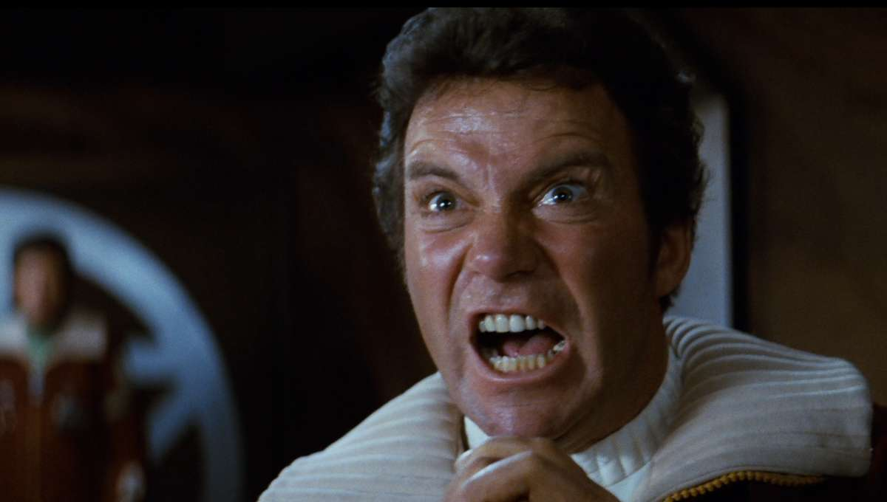
Does giving up make you mad? It should.

Slide 33
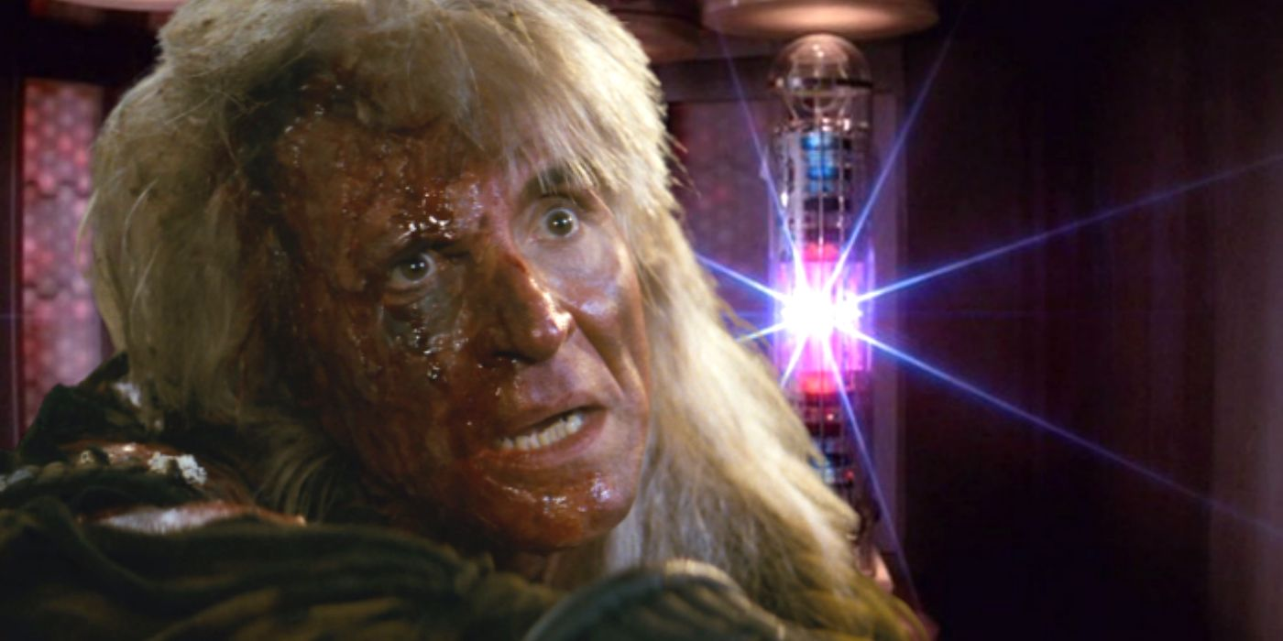
Because we need to win

Slide 34
A Winning Strategy - Layers of Defense
Email Hygiene
Patching
Authentication
Trust
Passwords
Backups
Social Media
Mobility
Tech Tools
Awareness
Six words to summarize everything
Two great books

Slide 35

Social Media and Disinformation Campaigns
https://www.computerweekly.com/opinion/Its-time-to-accept-that-disinformation-is-a-cyber-security-issue

Slide 36
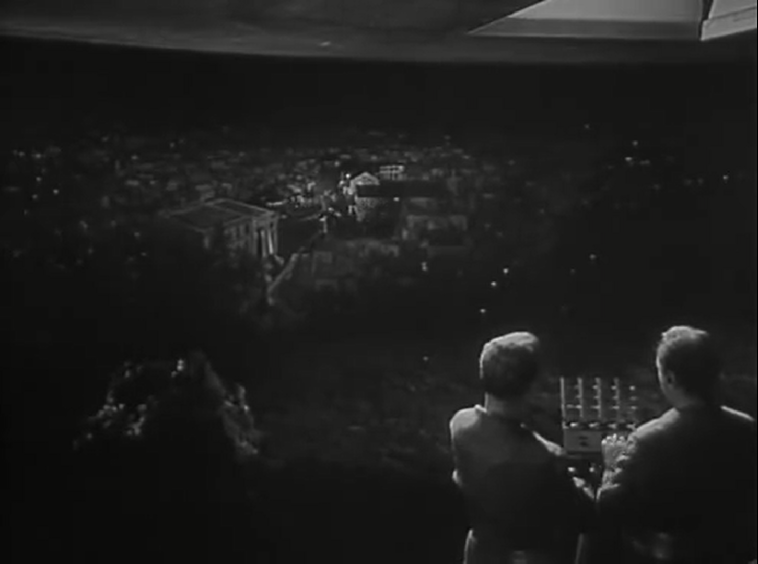
The Twilight Zone, Season 1, Episode 22: The Monsters are Due on Maple Street,
March 4, 1960

Slide 37
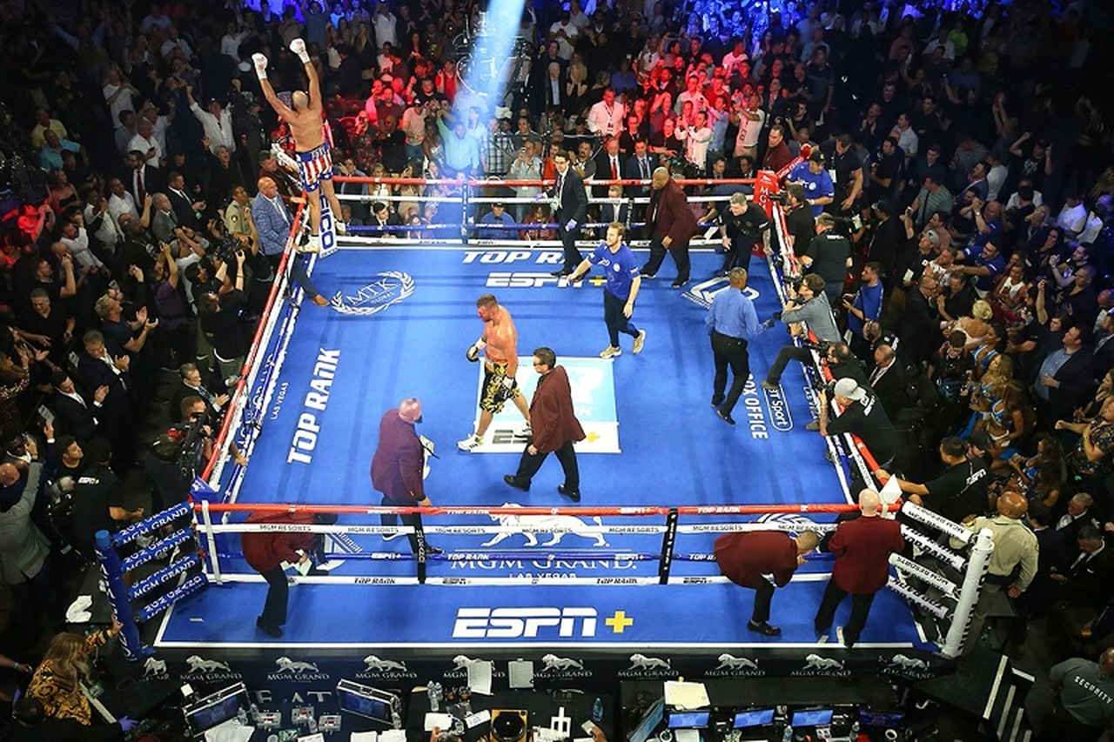

Slide 38
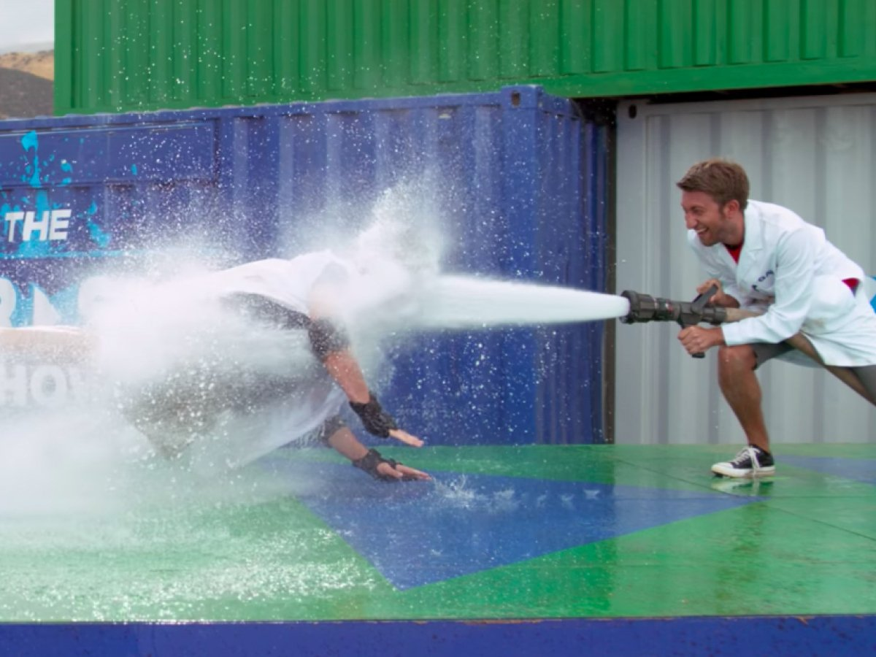
The firehose of falsehood
https://mashable.com/video/man-blasted-by-fire-hose-slow-motion

Slide 39
Versus
See https://www.rand.org/pubs/perspectives/PE198.html

Slide 40
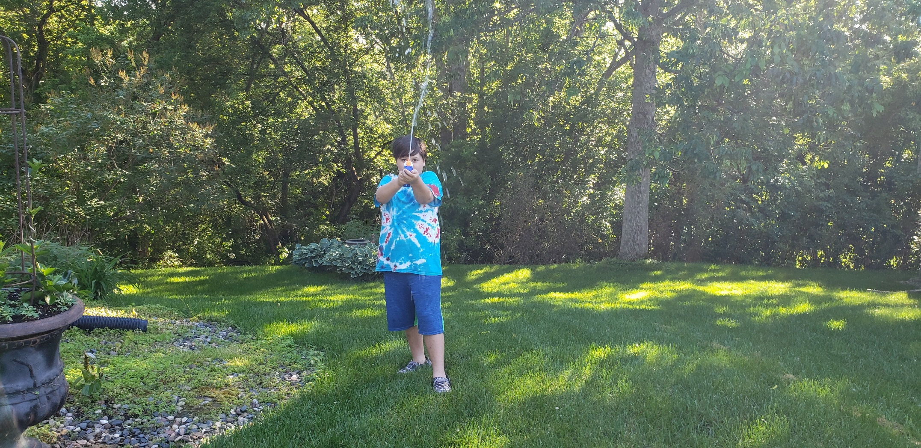
The squirt gun of truth

Slide 41
MIT: Lies travel farther and faster than truth
See https://news.mit.edu/2018/study-twitter-false-news-travels-faster-true-stories-0308
“We found that falsehood diffuses significantly farther, faster, deeper, and more broadly than the truth, in all categories of information, and in many cases by an order of magnitude,”
False news stories are 70 percent more likely to be retweeted than true stories.
It takes true stories about six times as long to reach 1,500 people as it does for false stories to reach the same number of people.
When it comes to Twitter’s “cascades,” or unbroken retweet chains, falsehoods reach a cascade depth of 10 about 20 times faster than facts.
Falsehoods are retweeted by unique users more broadly than true statements at every depth of cascade.

Slide 42
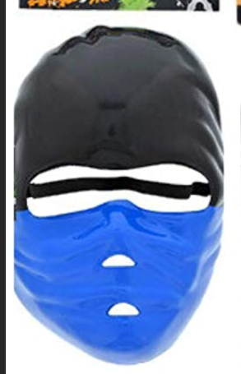
2019 social media mob up close and personal
See
https://www.dgregscott.com/when-dakota-county-mn-charged-my-11-year-old-grandson-with-5th-degree-assault-for-playing-in-a-park-in-a-costume/

Slide 43
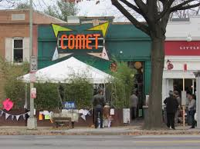
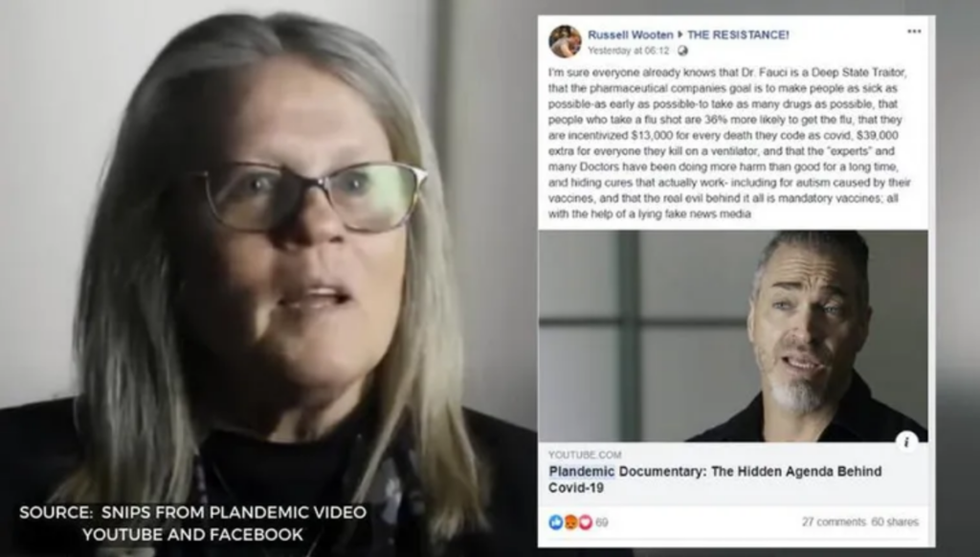
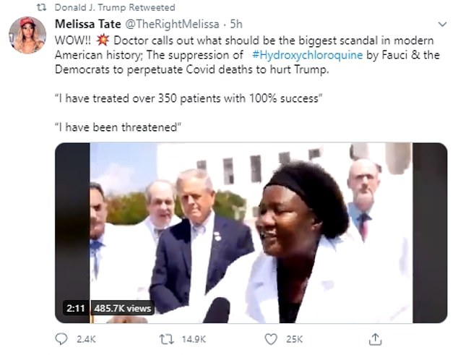
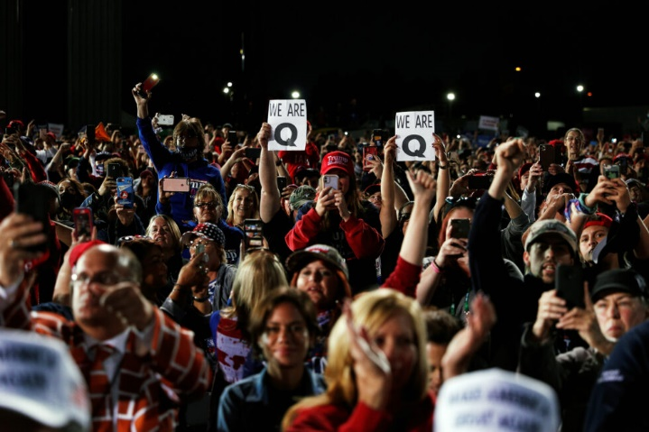
Comet, COVID, Conspiracies, Chaos
See
https://www.dgregscott.com/information-warfare-is-a-cybersecurity-thing-duh/

Slide 44
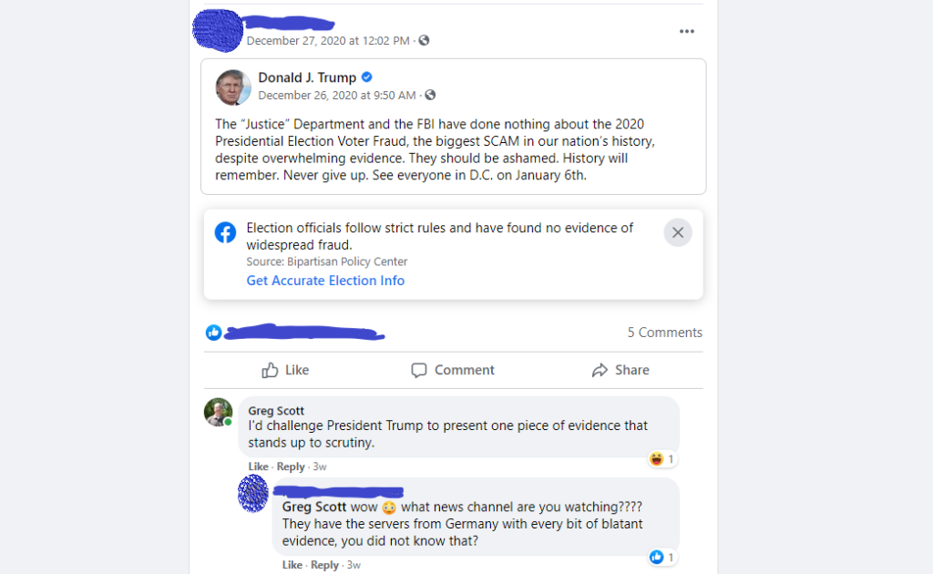

Slide 45
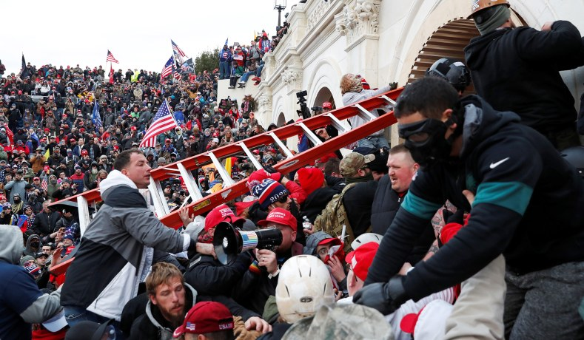
January 6, 2021

Slide 46
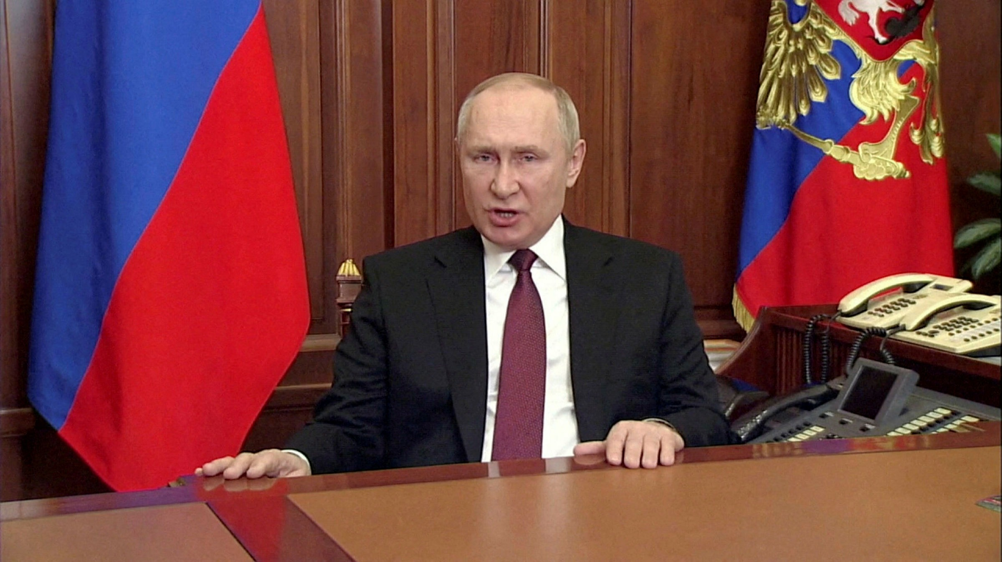
The Russians do it too
https://www.ft.com/content/73f87533-749a-4539-aeae-89ce0a9265bd

Slide 47
What do we do about it?
Social media companies
Ad-hoc censorship was a knee-jerk reaction and self-defeating.
Adopt circuit breakers, similar to stock market circuit breakers.
Amplify opposing points of view.
But business models built on maximizing emotional engagement.
The public
Learn to understand how social media companies make money.
Think before sharing.
Seek out opposing points of view.

Slide 48





Email hygiene

Slide 49
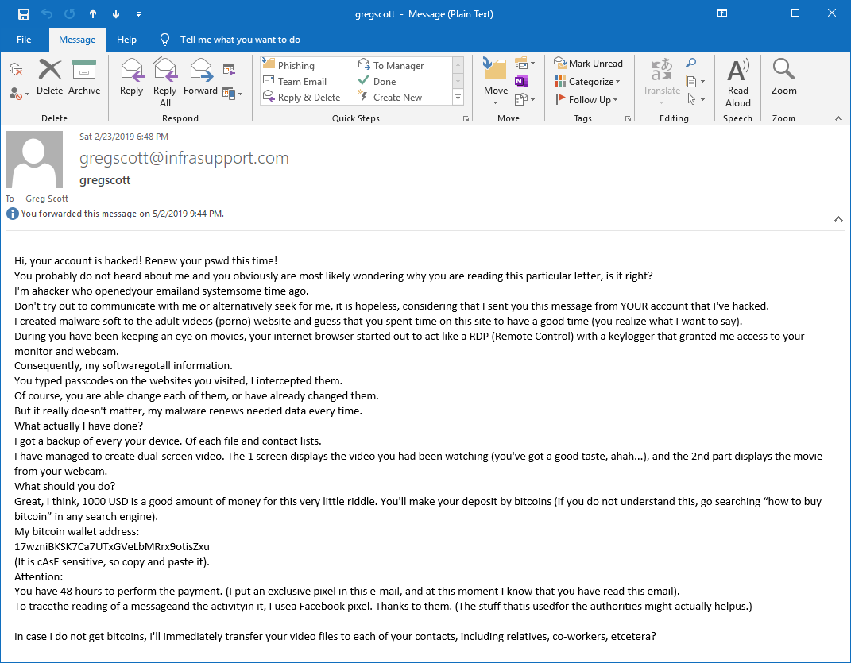
For lots of phishing samples, see https://www.dgregscott.com/category/phishy-emails/

Slide 50
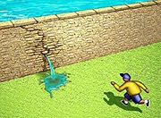
Patching

Slide 51
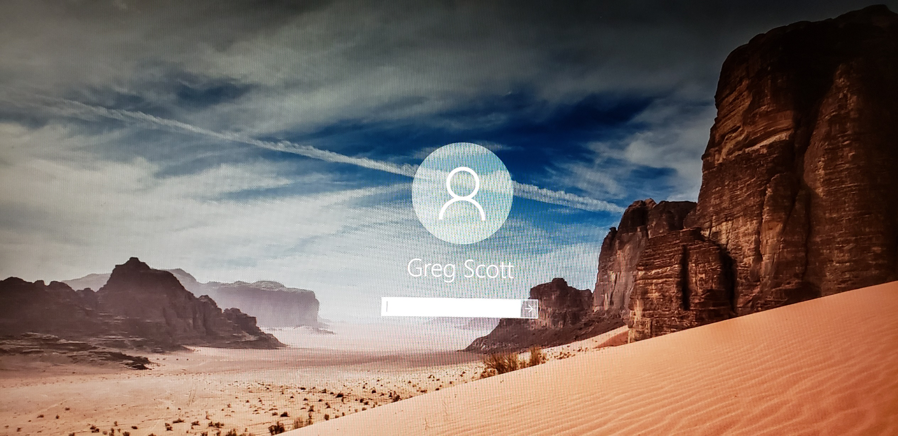
Authentication

Slide 52
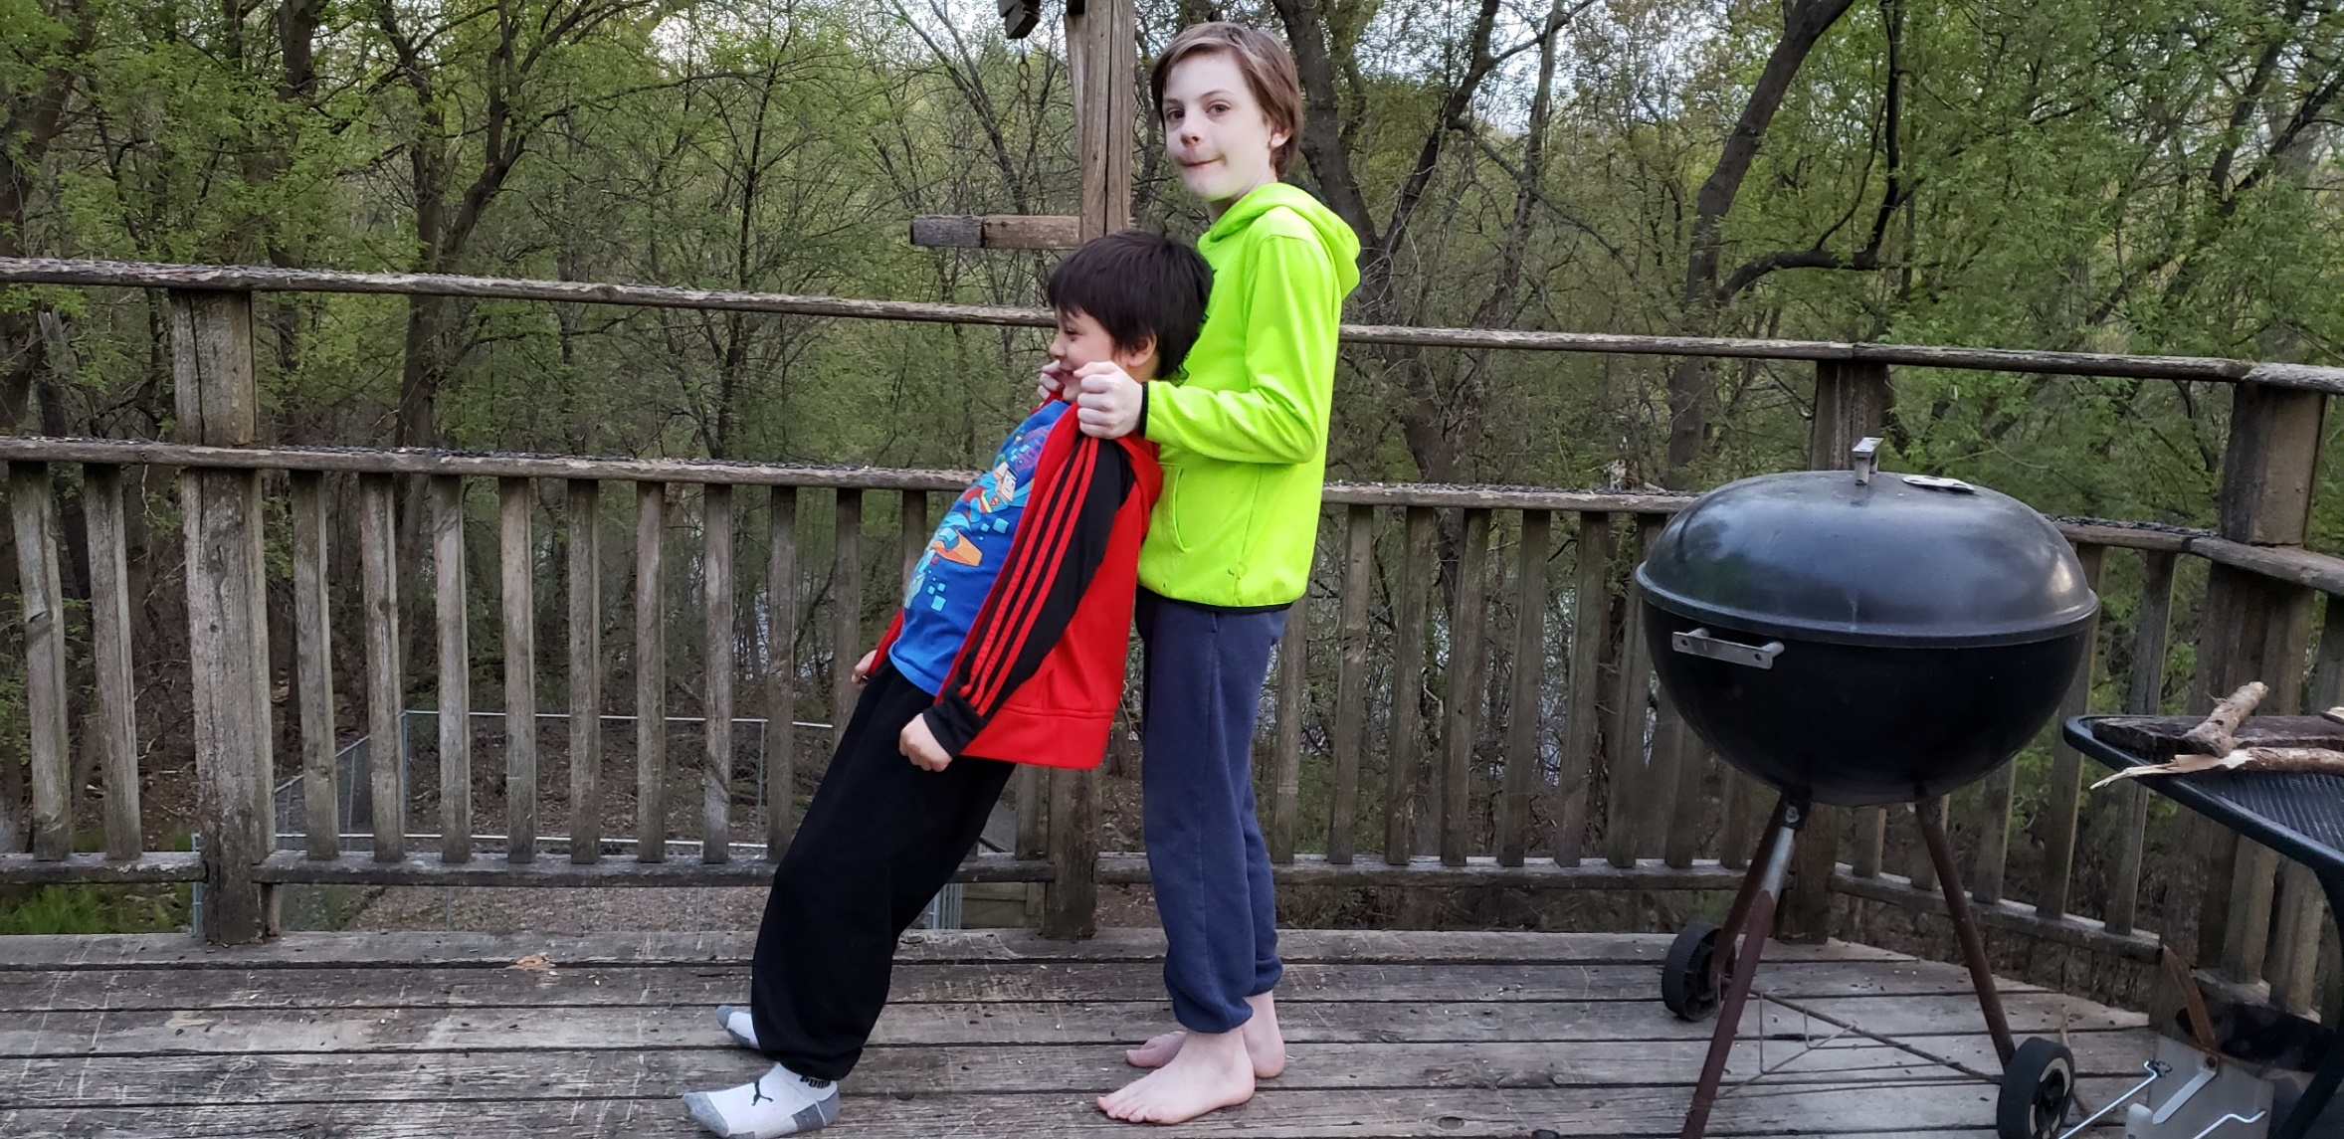
Trust
See https://www.dgregscott.com/internet-trust-mini-seminar/

Slide 53
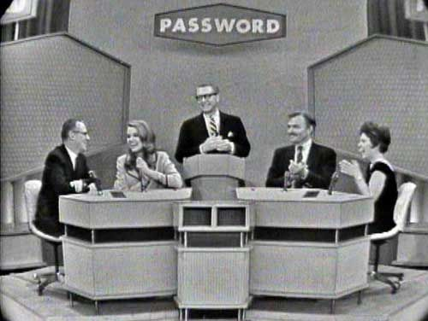
Passwords/Passphrases

Slide 54
Which do you like better?
A complex password with random characters: jHdfgy&4Jq*7
Or
A good passphrase: goodpassphrasesbeatcomplexpasswords
Goodpassphr@ses
See
https://www.dgregscott.com/passwords-must-die-long-live-passphrases/

Slide 55
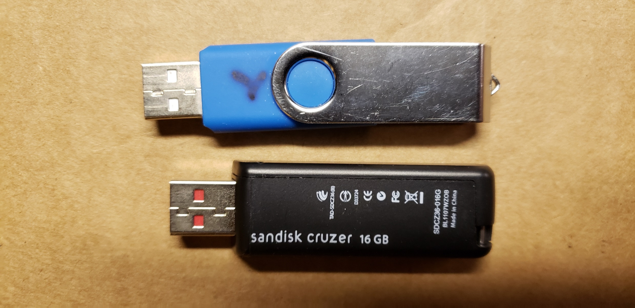
Backups

Slide 56
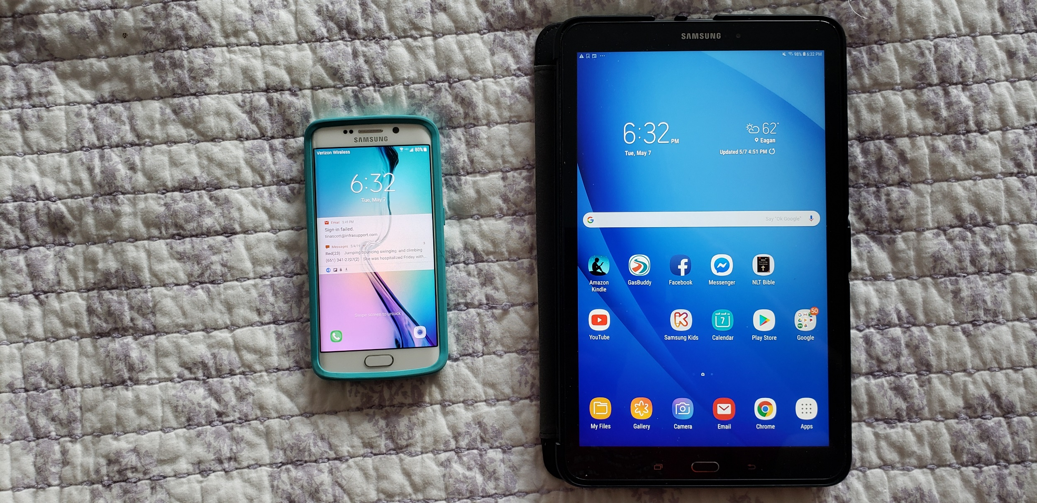
Mobility

Slide 57
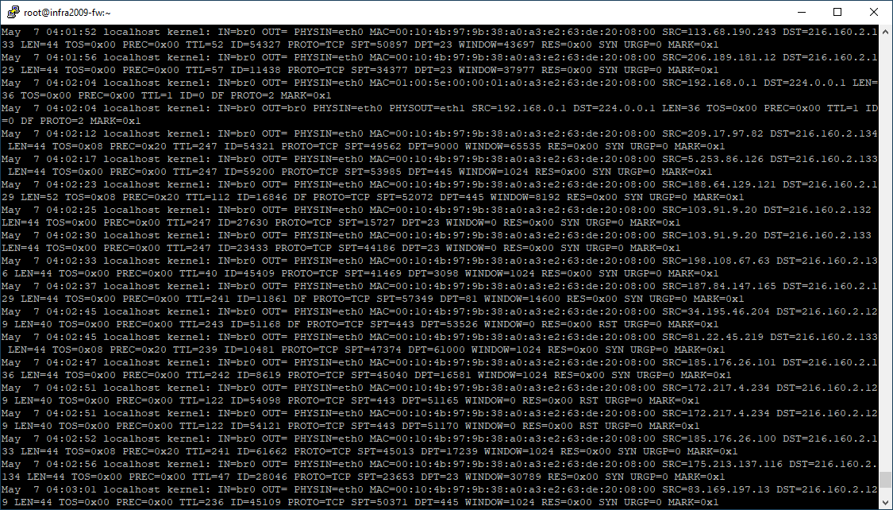
Tech Tools

Slide 58
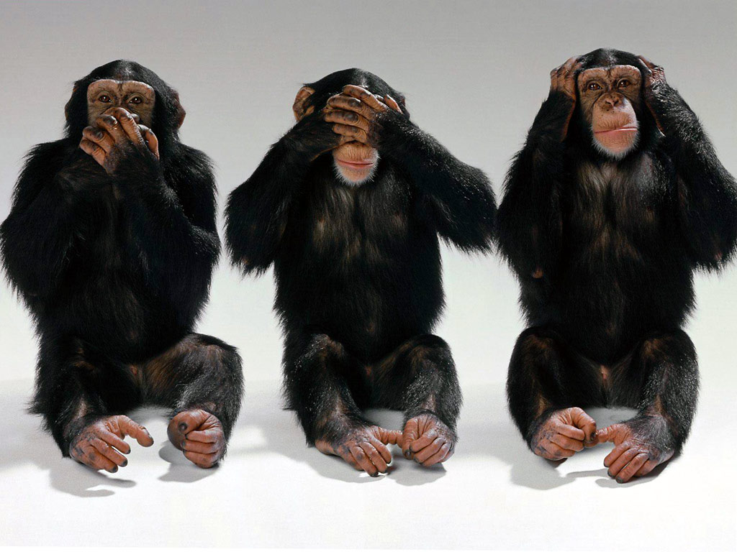
Awareness

Slide 59
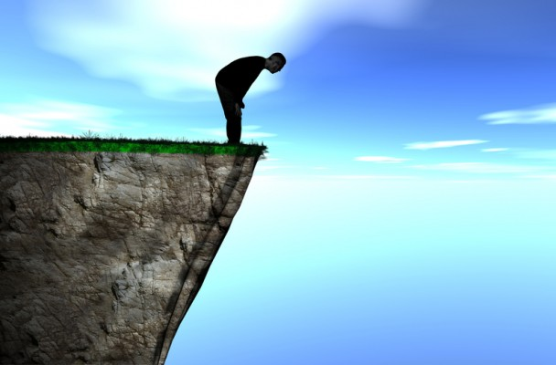
“I don’t have time for this. Just tell me what I need to know in 25 words or less.”

Slide 60
Everything busy leaders need to know about cyber-security
Distilled into a six word rhyme anyone can remember.
Care and share to be prepared.
Everything flows from that.

Slide 61
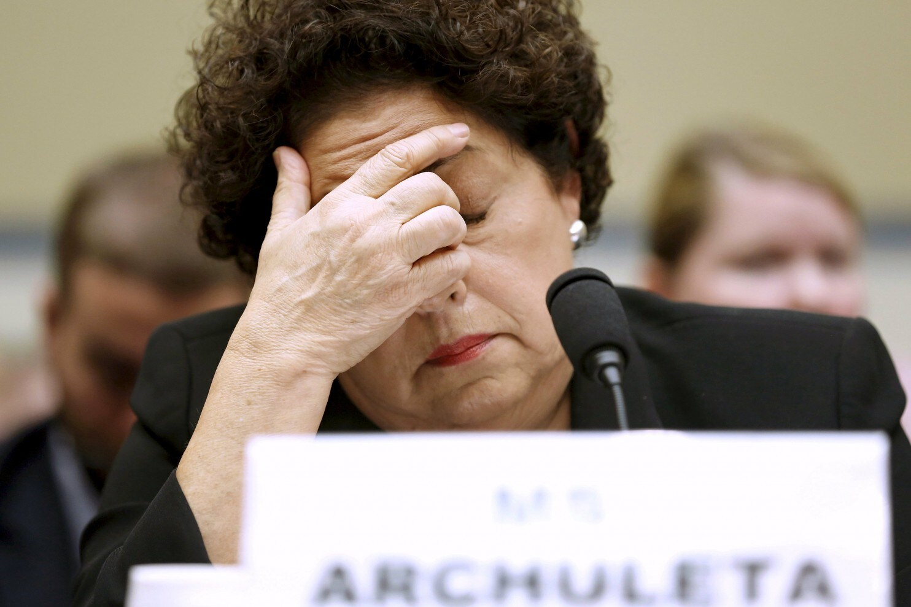
Care!!
Message to busy business leaders:
Pay more than lip service.
Or enjoy the consequences of the next incident.
“We take security seriously.”
From https://www.csoonline.com/article/2946955/opm-director-resigns-after-unprecedented-data-breach.html

Slide 62
Share
A commercial, and in some respects a social, doubt has been started within the last year or two, whether or not it is right to discuss so openly the security or insecurity of locks. Many well-meaning persons suppose that the discussion respecting the means for baffling the supposed safety of locks offers a premium for dishonesty, by shewing others how to be dishonest. This is a fallacy. Rogues are very keen in their profession, and they know already much more than we can teach them respecting their several kinds of roguery. Rogues knew a good deal about lock-picking long before locksmiths discussed it among themselves, as they have lately done. If a lock—let it have been made in whatever country, or by whatever maker—is not so inviolable as it has hitherto been deemed to be, surely it is to the interest of honest persons to know this fact, because the dishonest are tolerably certain to be the first to apply the knowledge practically; and the spread of the knowledge is necessary to give fair play to those who might suffer by ignorance.
  Alfred Charles Hobbs, “Rudimentary Treatise on the Construction of Locks,” edited by Charles Tomlinson, published in 1853, page 2.
Also see https://www.dgregscott.com/a-radical-not-so-new-idea-to-stop-the-daily-barrage-of-data-breaches/

Slide 63
Which do you prefer?
Embarrassment during peer reviews with other good guys?
Or…
Embarrassment or worse in front of the whole world after somebody plunders you?
I practice what I preach. See
https://www.dgregscott.com/time-to-man-up-swallow-my-pride/

Slide 64
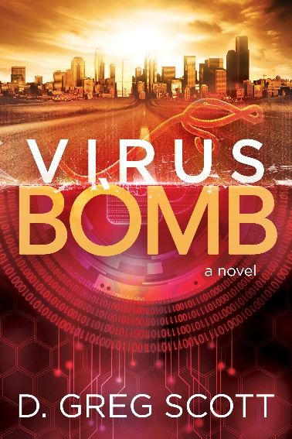
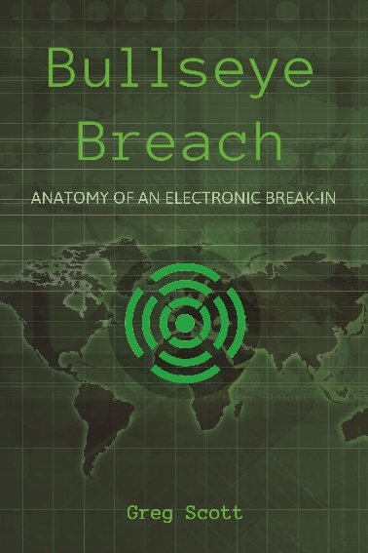
Two Great Books

Slide 65
Security is a process, not an event
Share what you learn with other good guys.
Expect Demand other good guys share what they learn with you.
Apply what you learn; repeat and refine continuously.
Security is a process, not an event.

Slide 66
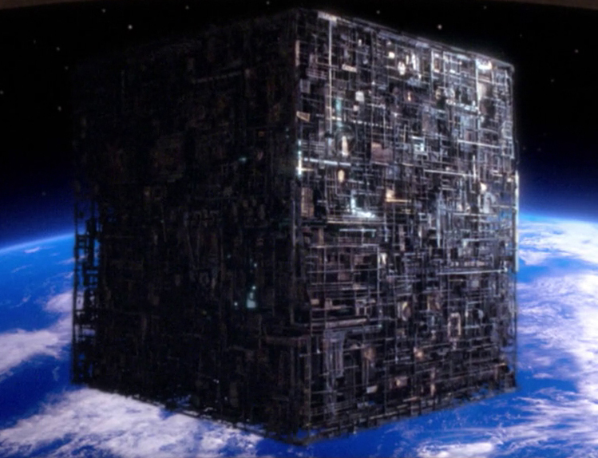
Resistance is not futile.

Slide 67

Con games are alive and well today and live on the Internet
For a great satire blog post, see:
https://www.dgregscott.com/social-media-mobs-not-just-fringe-groups-any-more/

Slide 68

One more plug
To opt in and get these tips delivered to your inbox:
Go to my website
Click the big red button
Fill out the form

Slide 69

Contact info
gregscott@infrasupport.com or
gregscott@dgregscott.com https://www.dgregscott.com
Twitter: DGregScott
LinkedIn: https://www.linkedin.com/in/dgregscott/
Facebook: https://www.facebook.com/D-Greg-Scott-author-112197323547623
Youtube: “Greg Scott Public Videos” at https://www.youtube.com/channel/UCBtDWsqzMZ_RB94I_F4cnRQ

